Slide 1
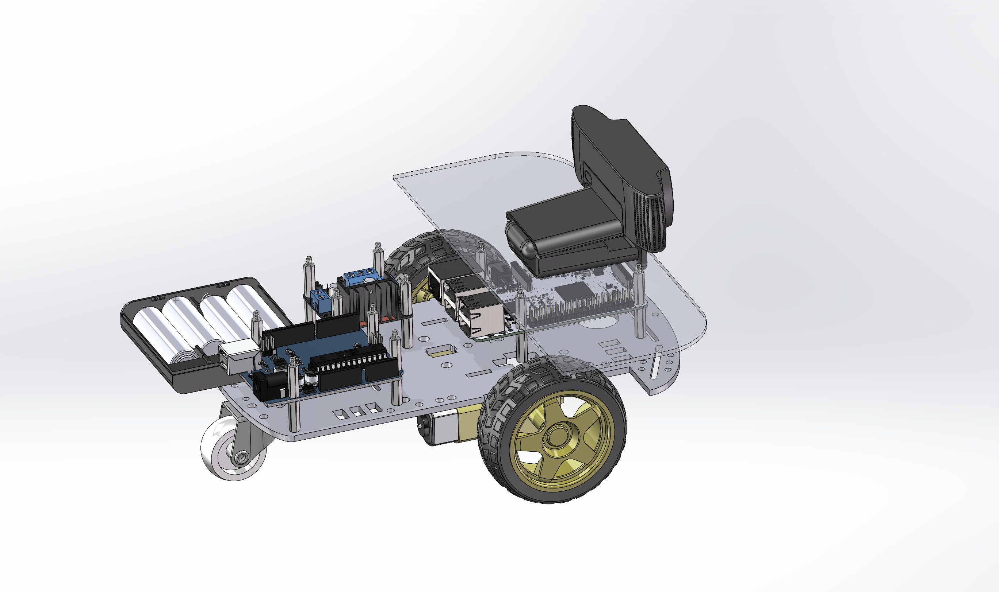
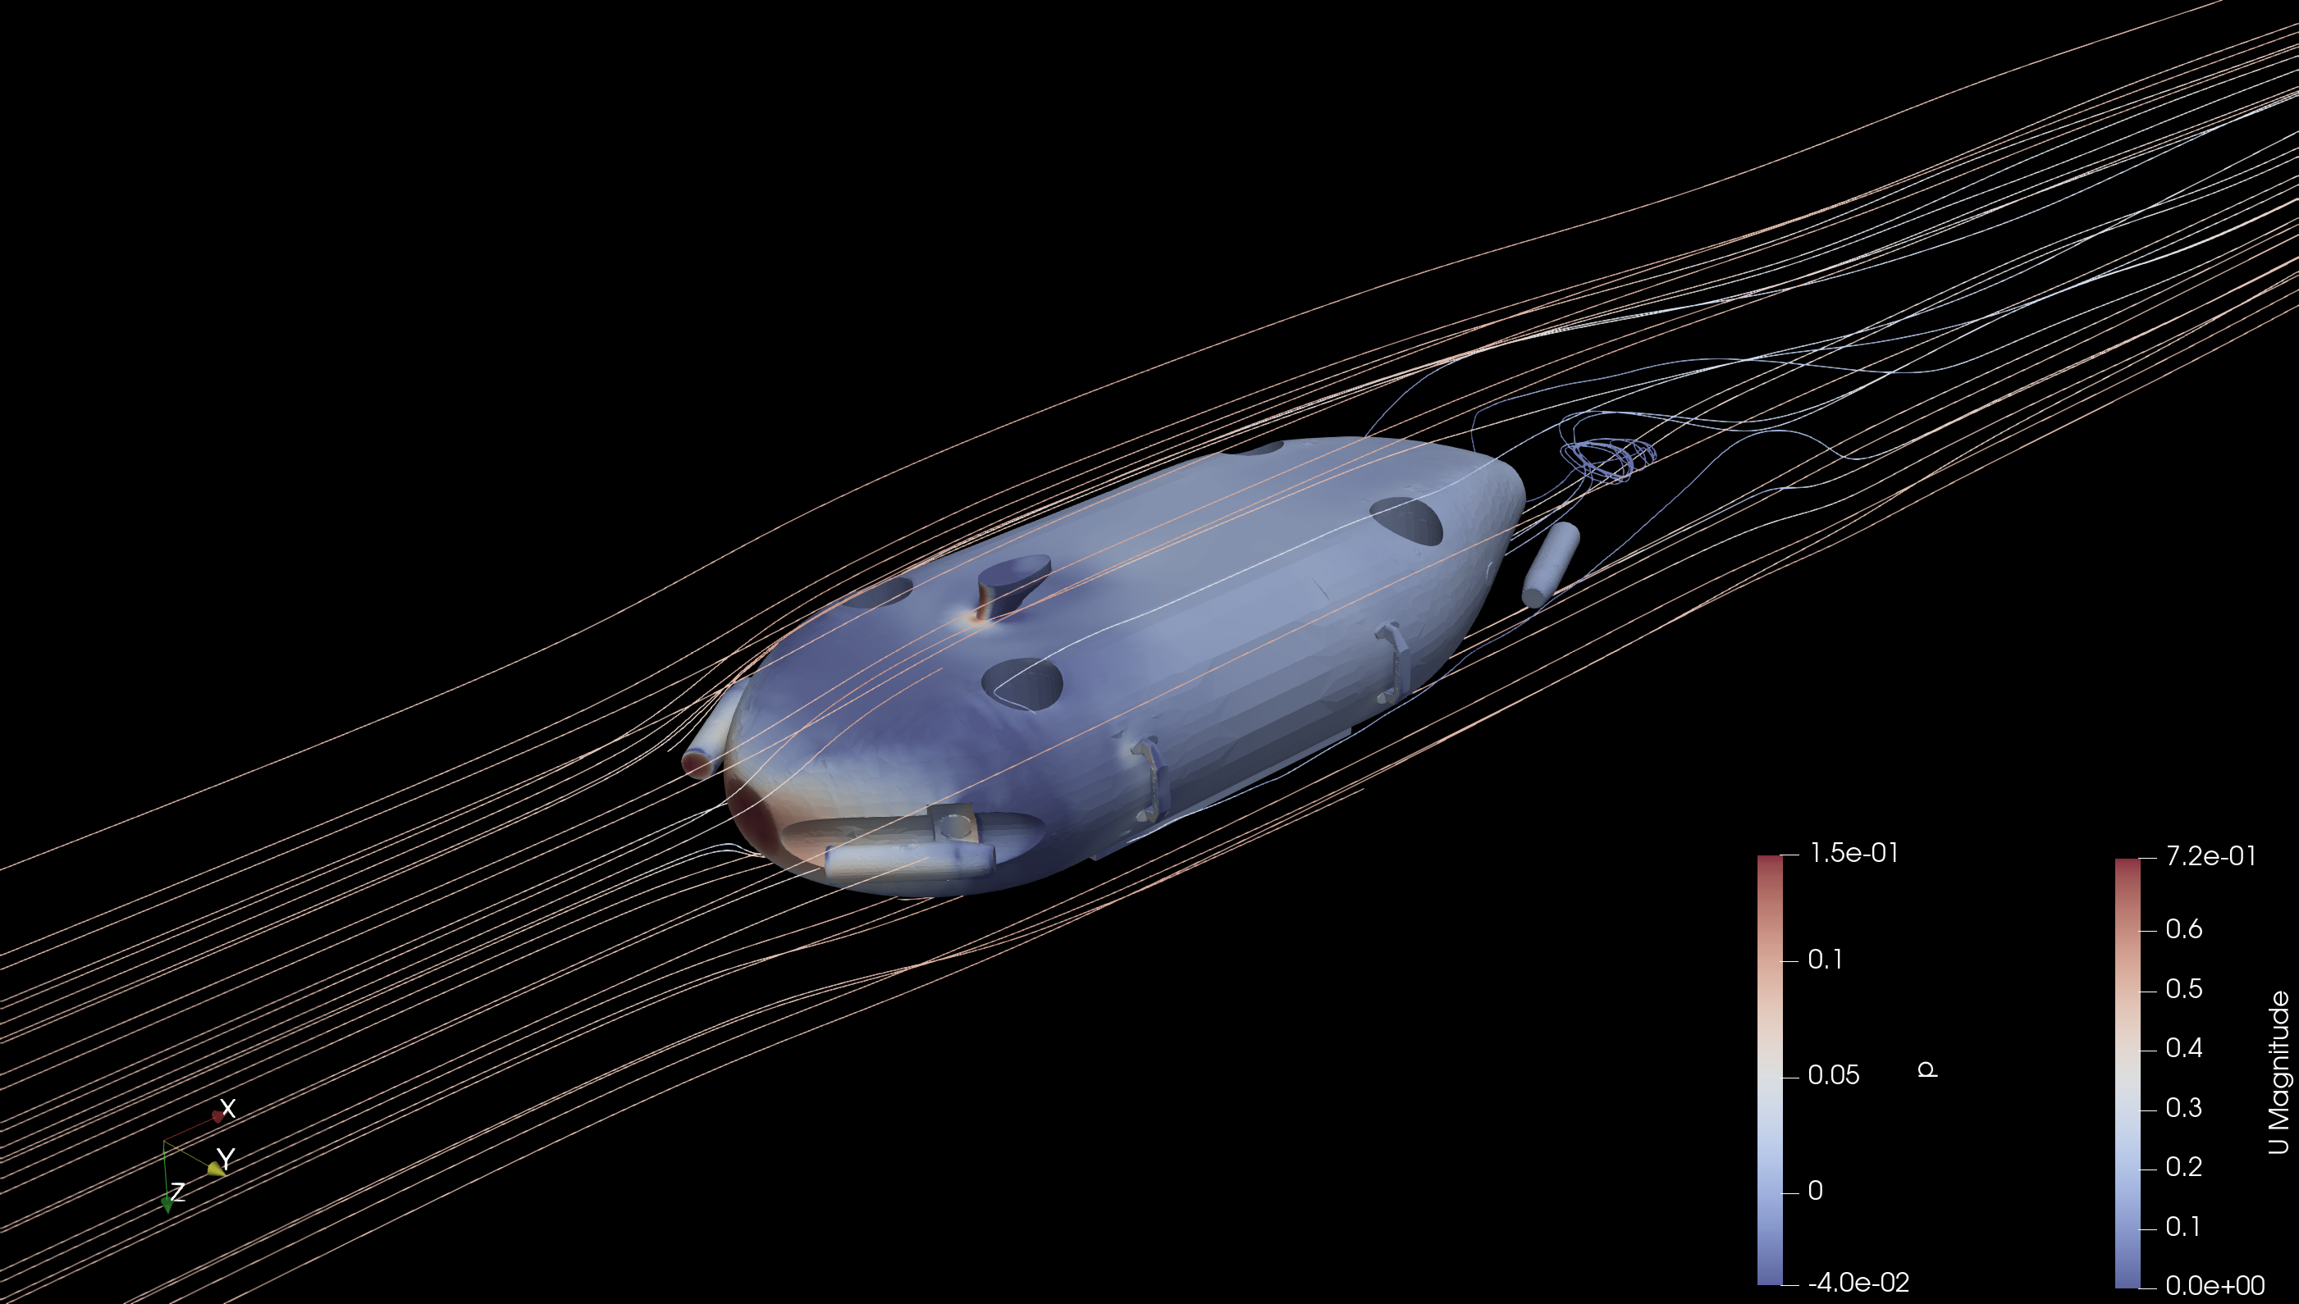
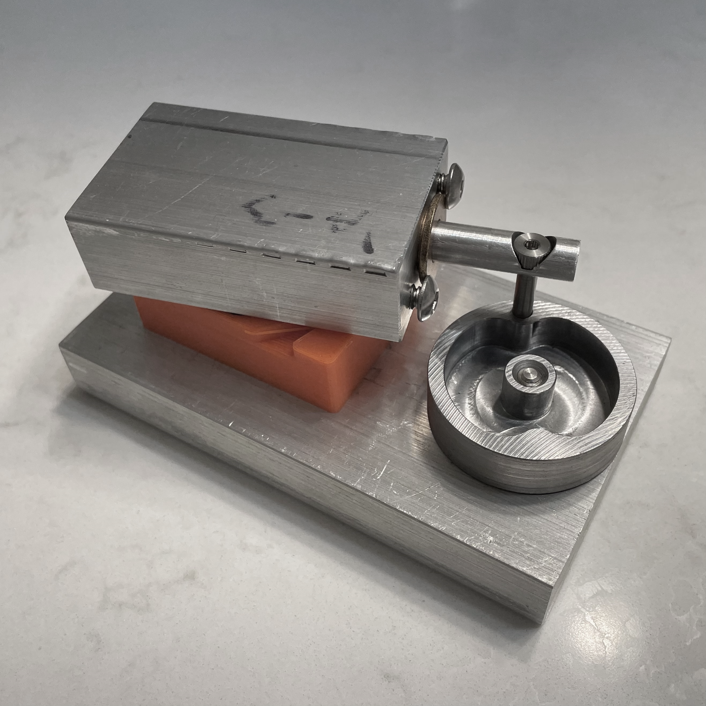
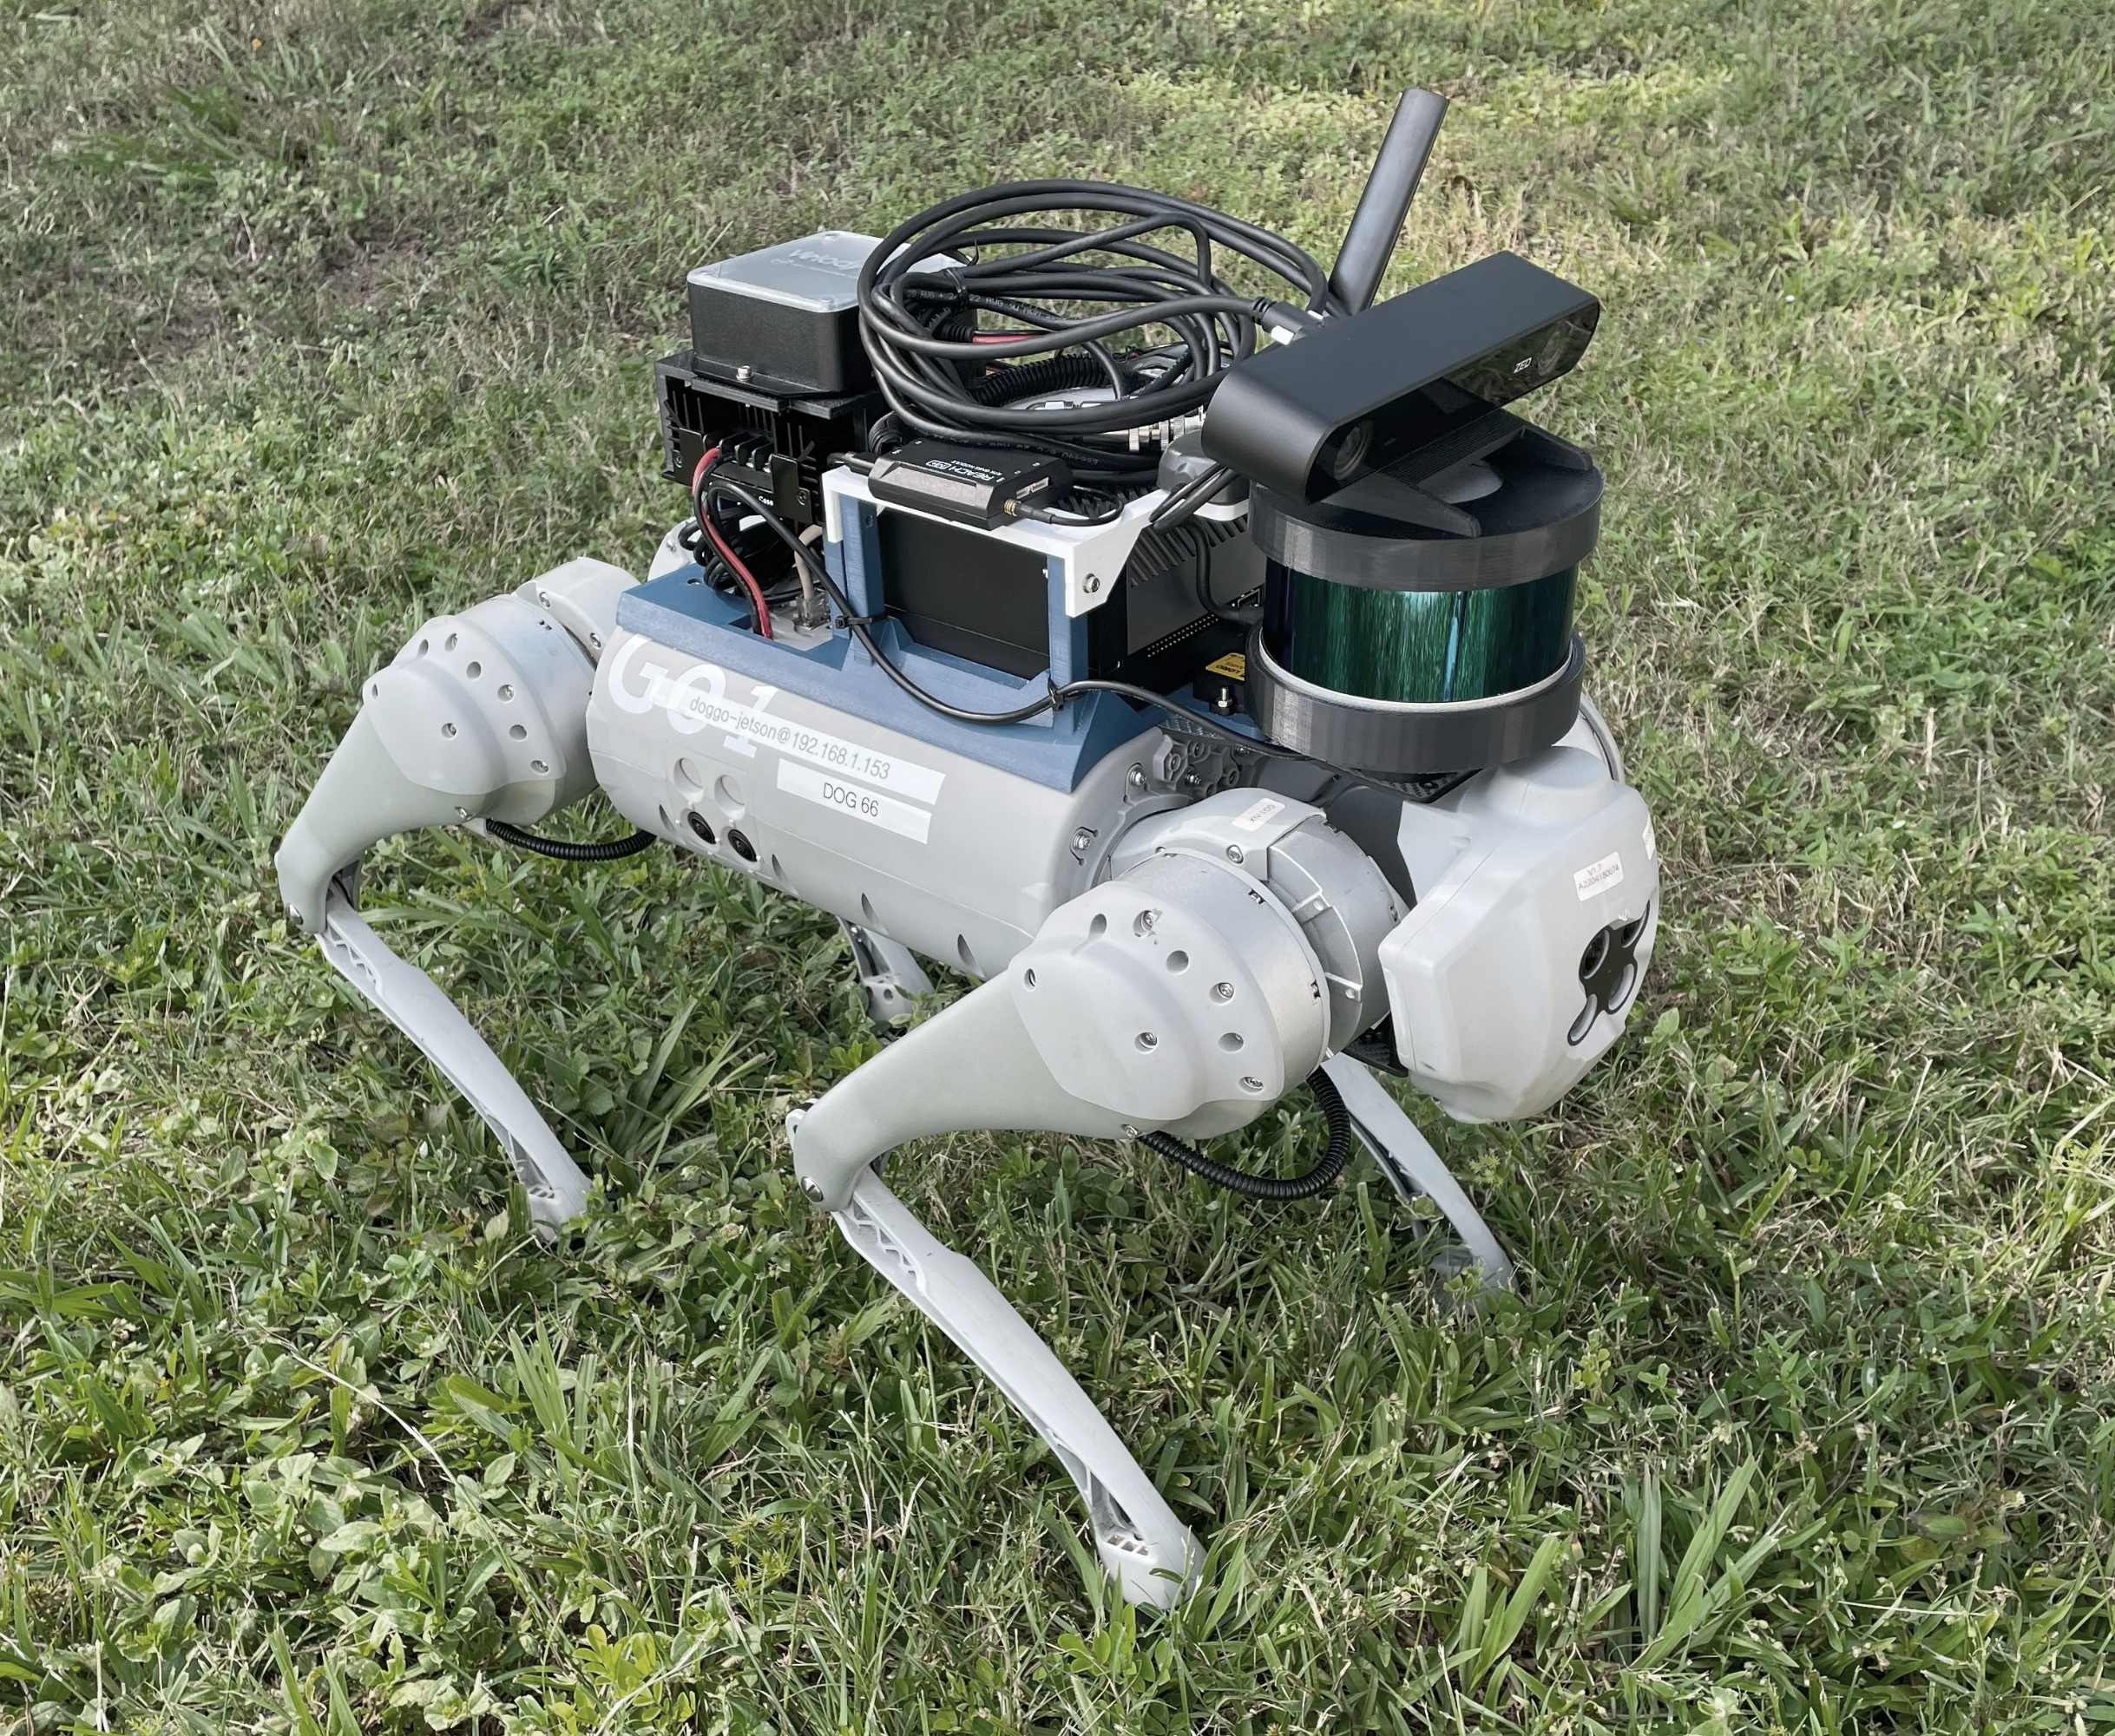
James “Wyatt” Cross
Engineering Portfolio
Contents
CFD Internship
Homemade TurtleBot
Robot Backpacks
Robot Emergency Stop
Design and Manufacturing Laboratory Air Engine
Design and Manufacturing Laboratory Technical Reports
Autonomous Vehicles Class

Slide 2
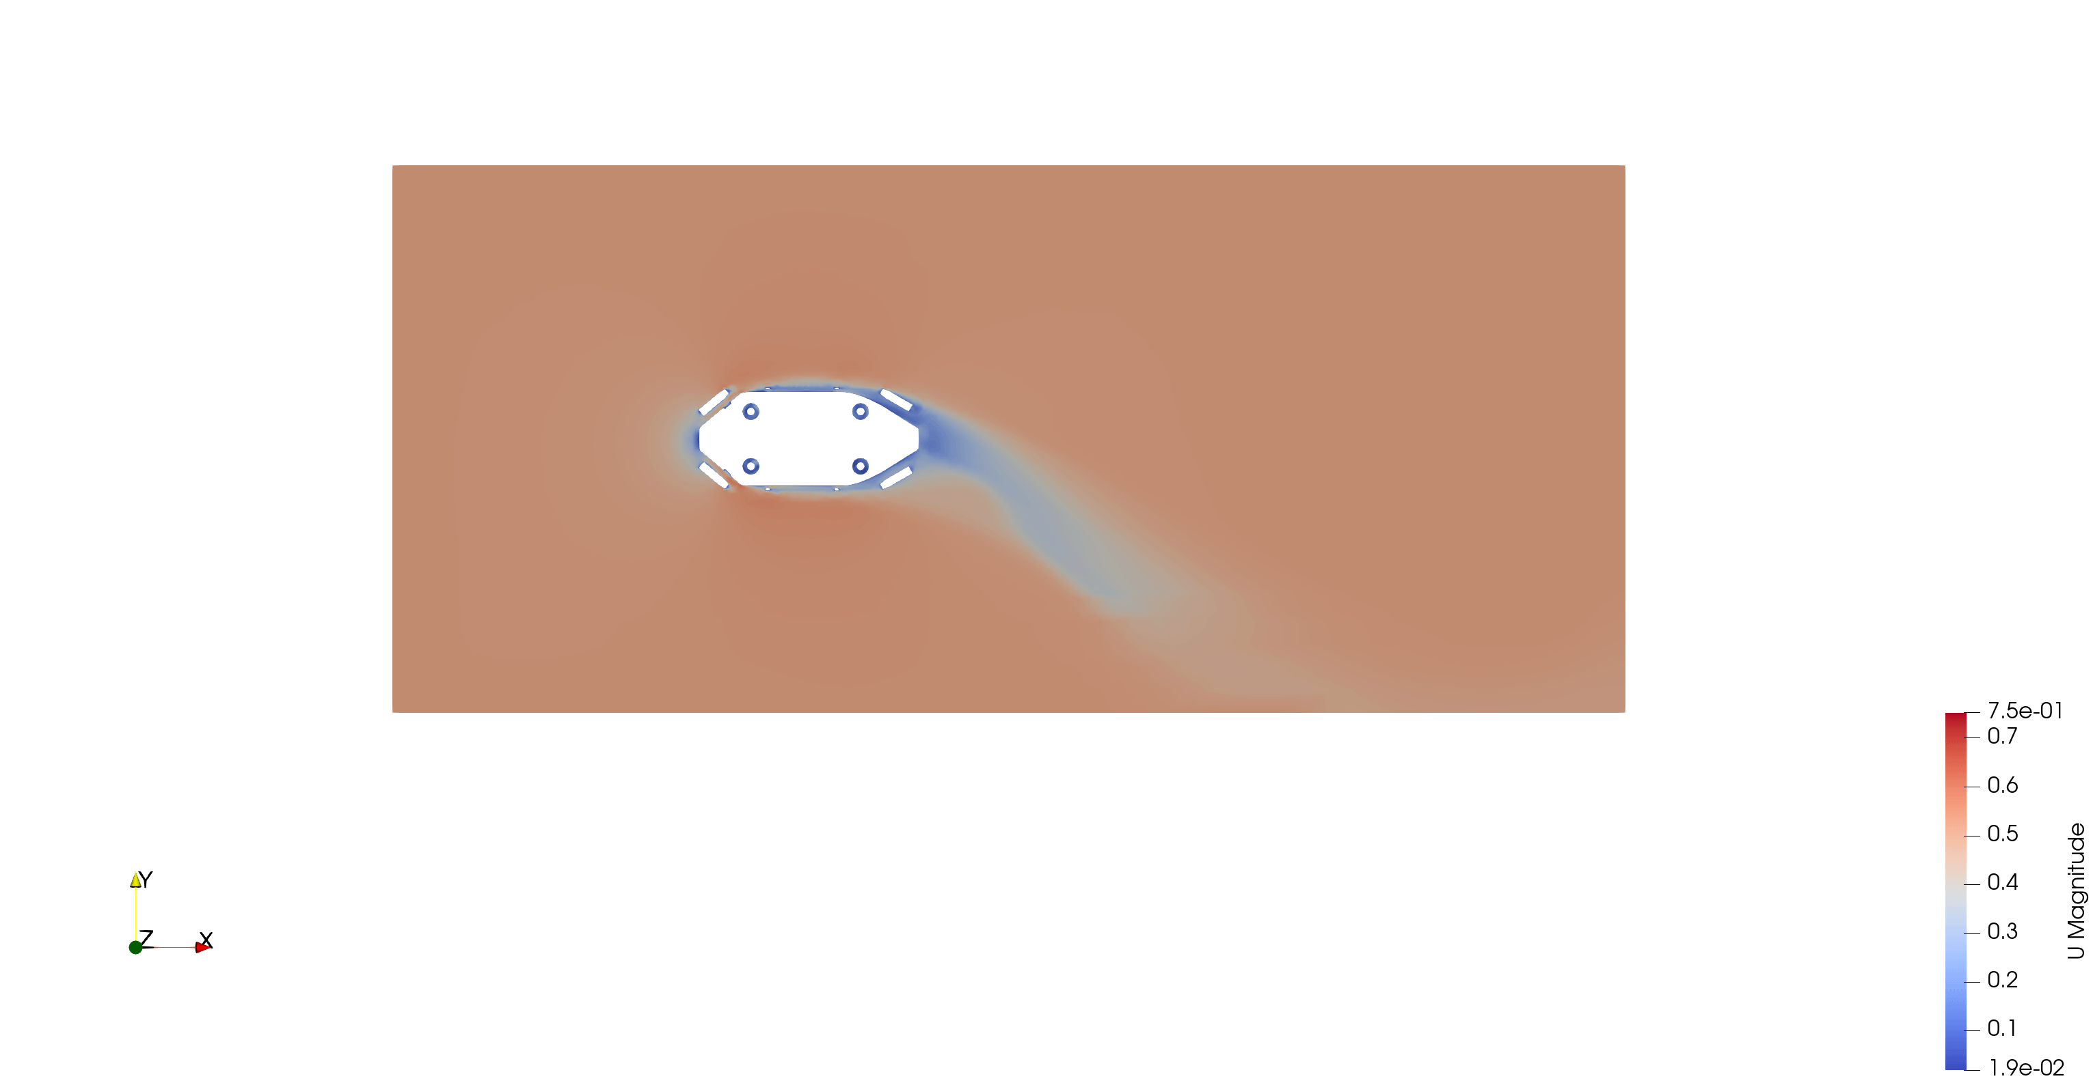
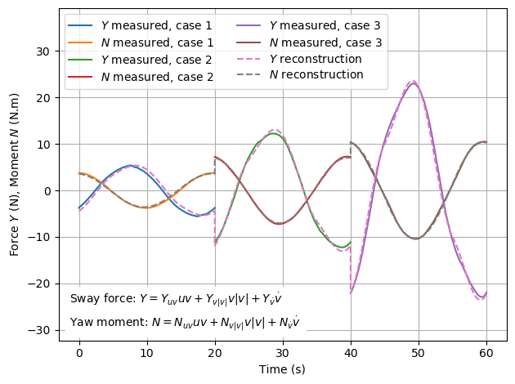
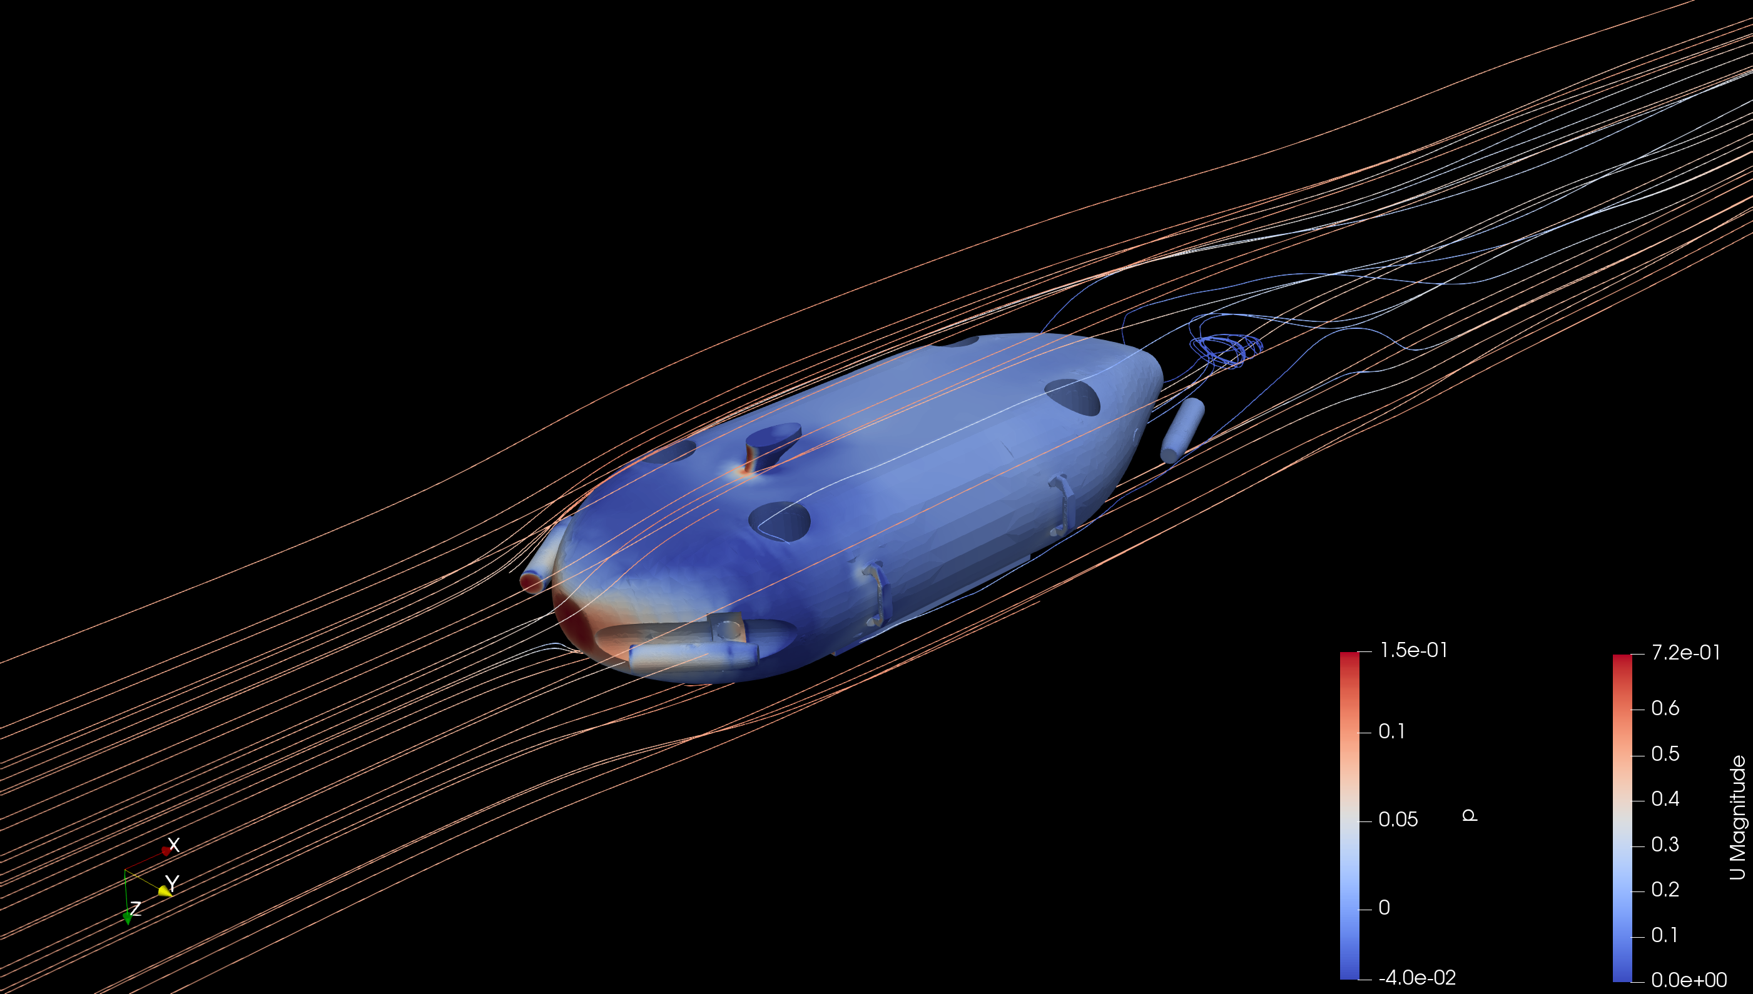
1
Internship – Hydrodynamic Coefficient Determination (Summer 2023)
I worked primarily on developing a Computational Fluid Dynamics (CFD) model for an Uncrewed Underwater Vehicle (UUV). I worked with a team to estimate hydrodynamic coefficients that can be implemented into a model-based controller for a more robust vehicle control system.
Through mentorship and self study, I learned how to use OpenFOAM for CFD meshing and solving in 10 weeks. Meshing presented challenges as the included tool, snappyHexMesh, was highly automated but struggled with sharp corners in the vehicle geometry. I resolved this issue with additional meshing iterations and trying many meshing parameters to fix areas that would taint the results.

Slide 3
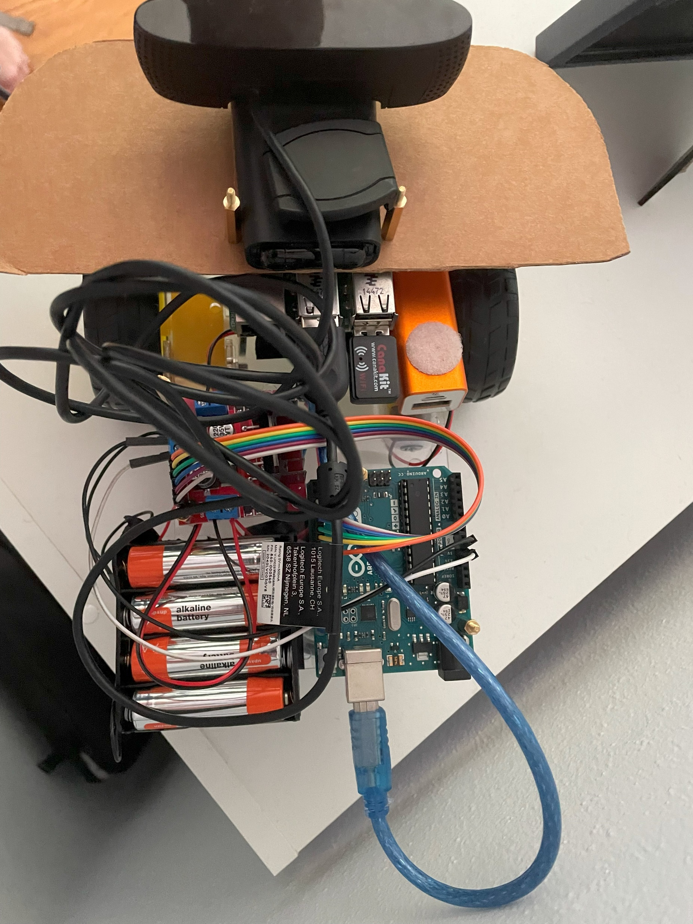
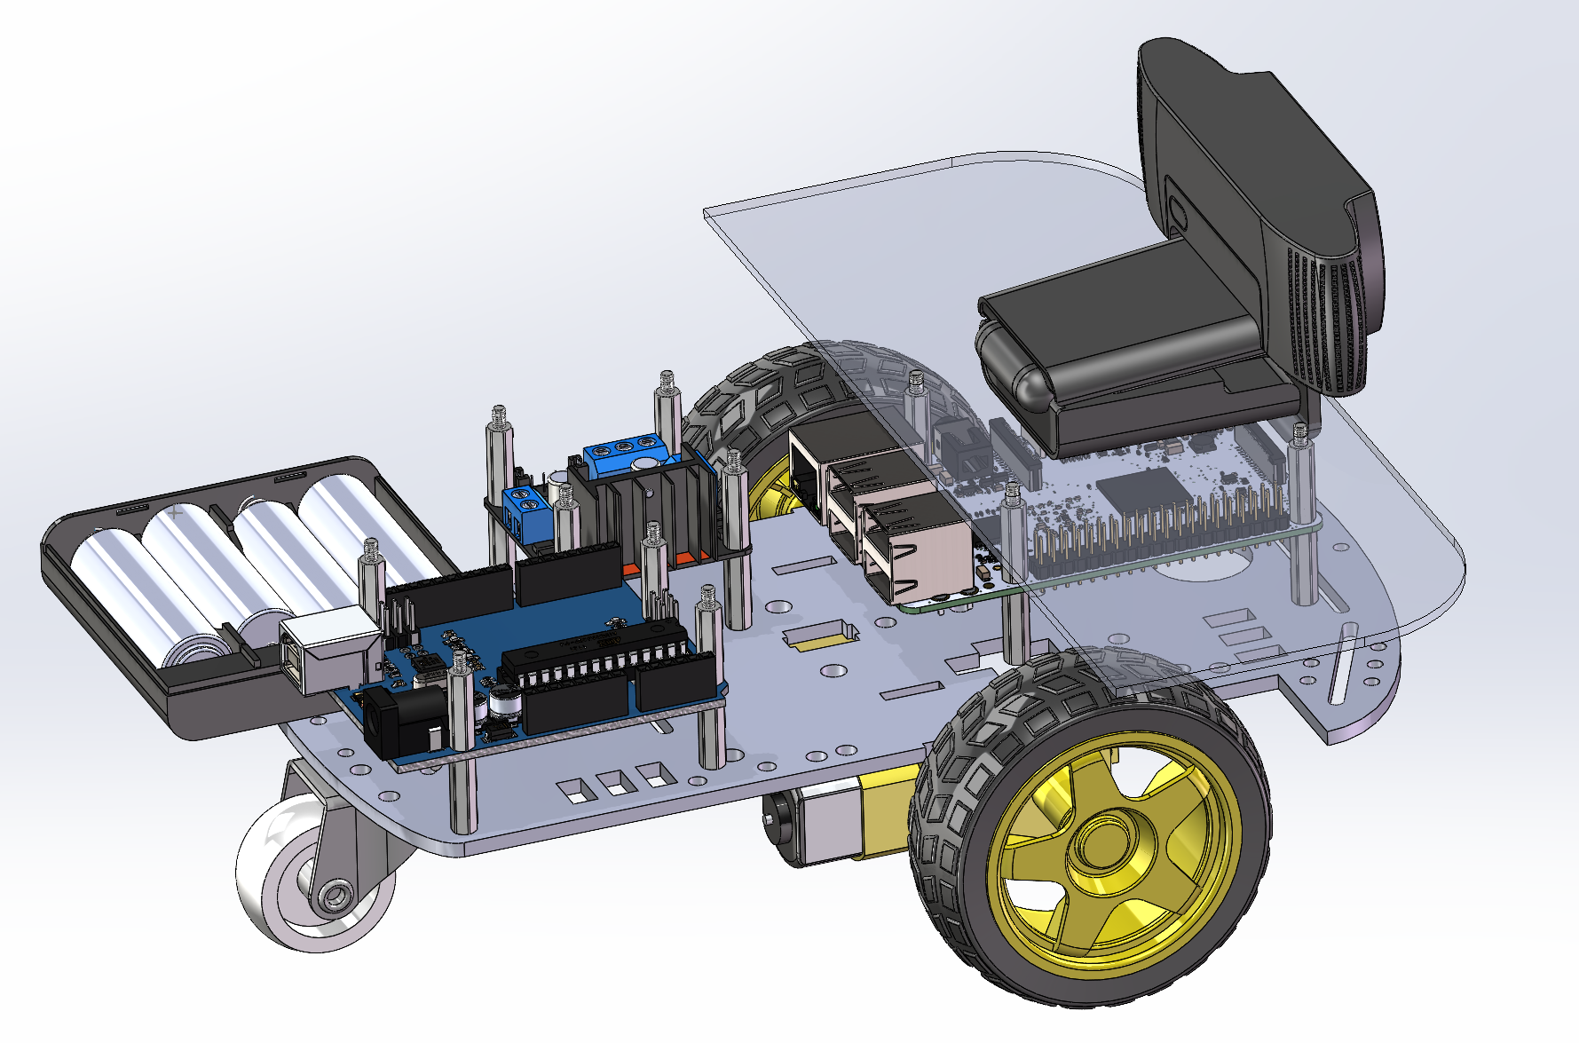
Homemade TurtleBot (Summer 2023)
2
Background: I was interested in understanding how wheeled ground robots are built. I had previously worked with ground robots at a high level, receiving sensor data and sending velocity/heading commands.
Design: I started with the bare minimum to move: A L298N motor drive, 2 brushed motors and a battery. As I iterated on my design, I added a microcontroller for motor control, and a single board for streaming images and commanding heading or velocity wirelessly.
Future Work: I want to add a GPS module to log position and work on filtering GPS signals along with a IMU to gain more control over velocity and heading as the current design can only regulate voltage.

Slide 4
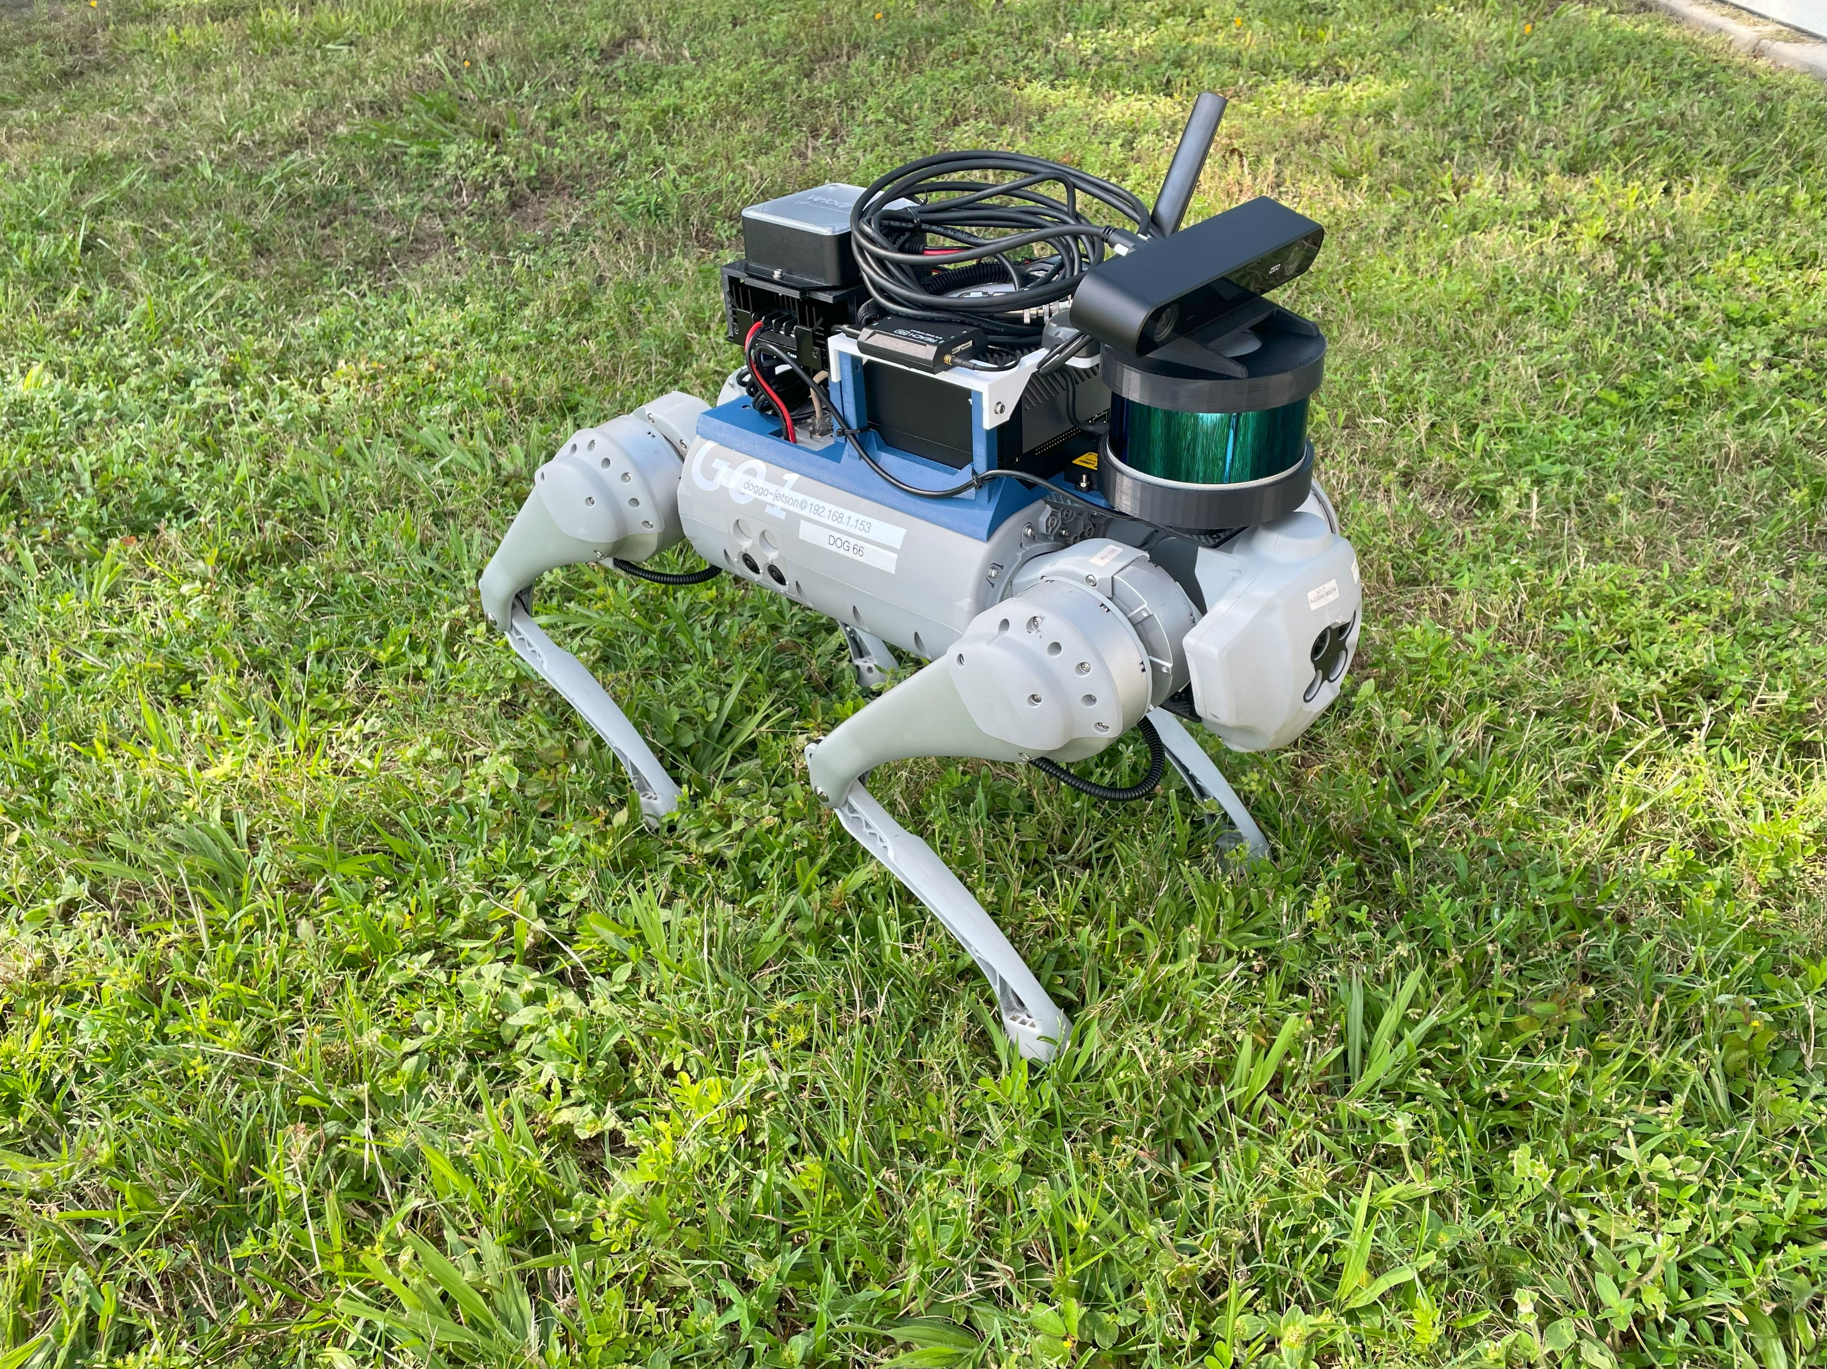
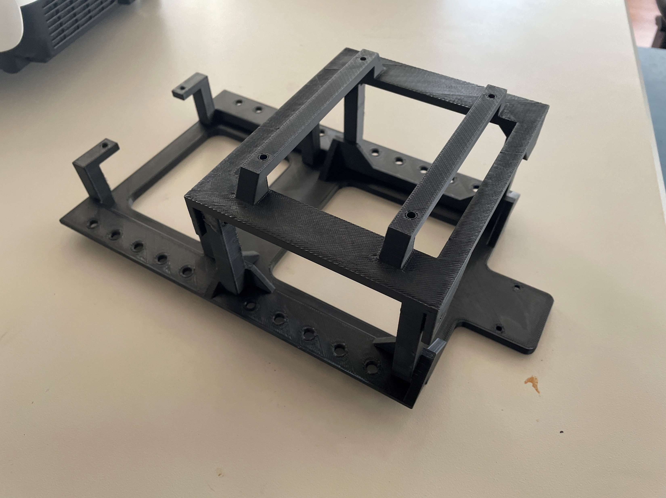
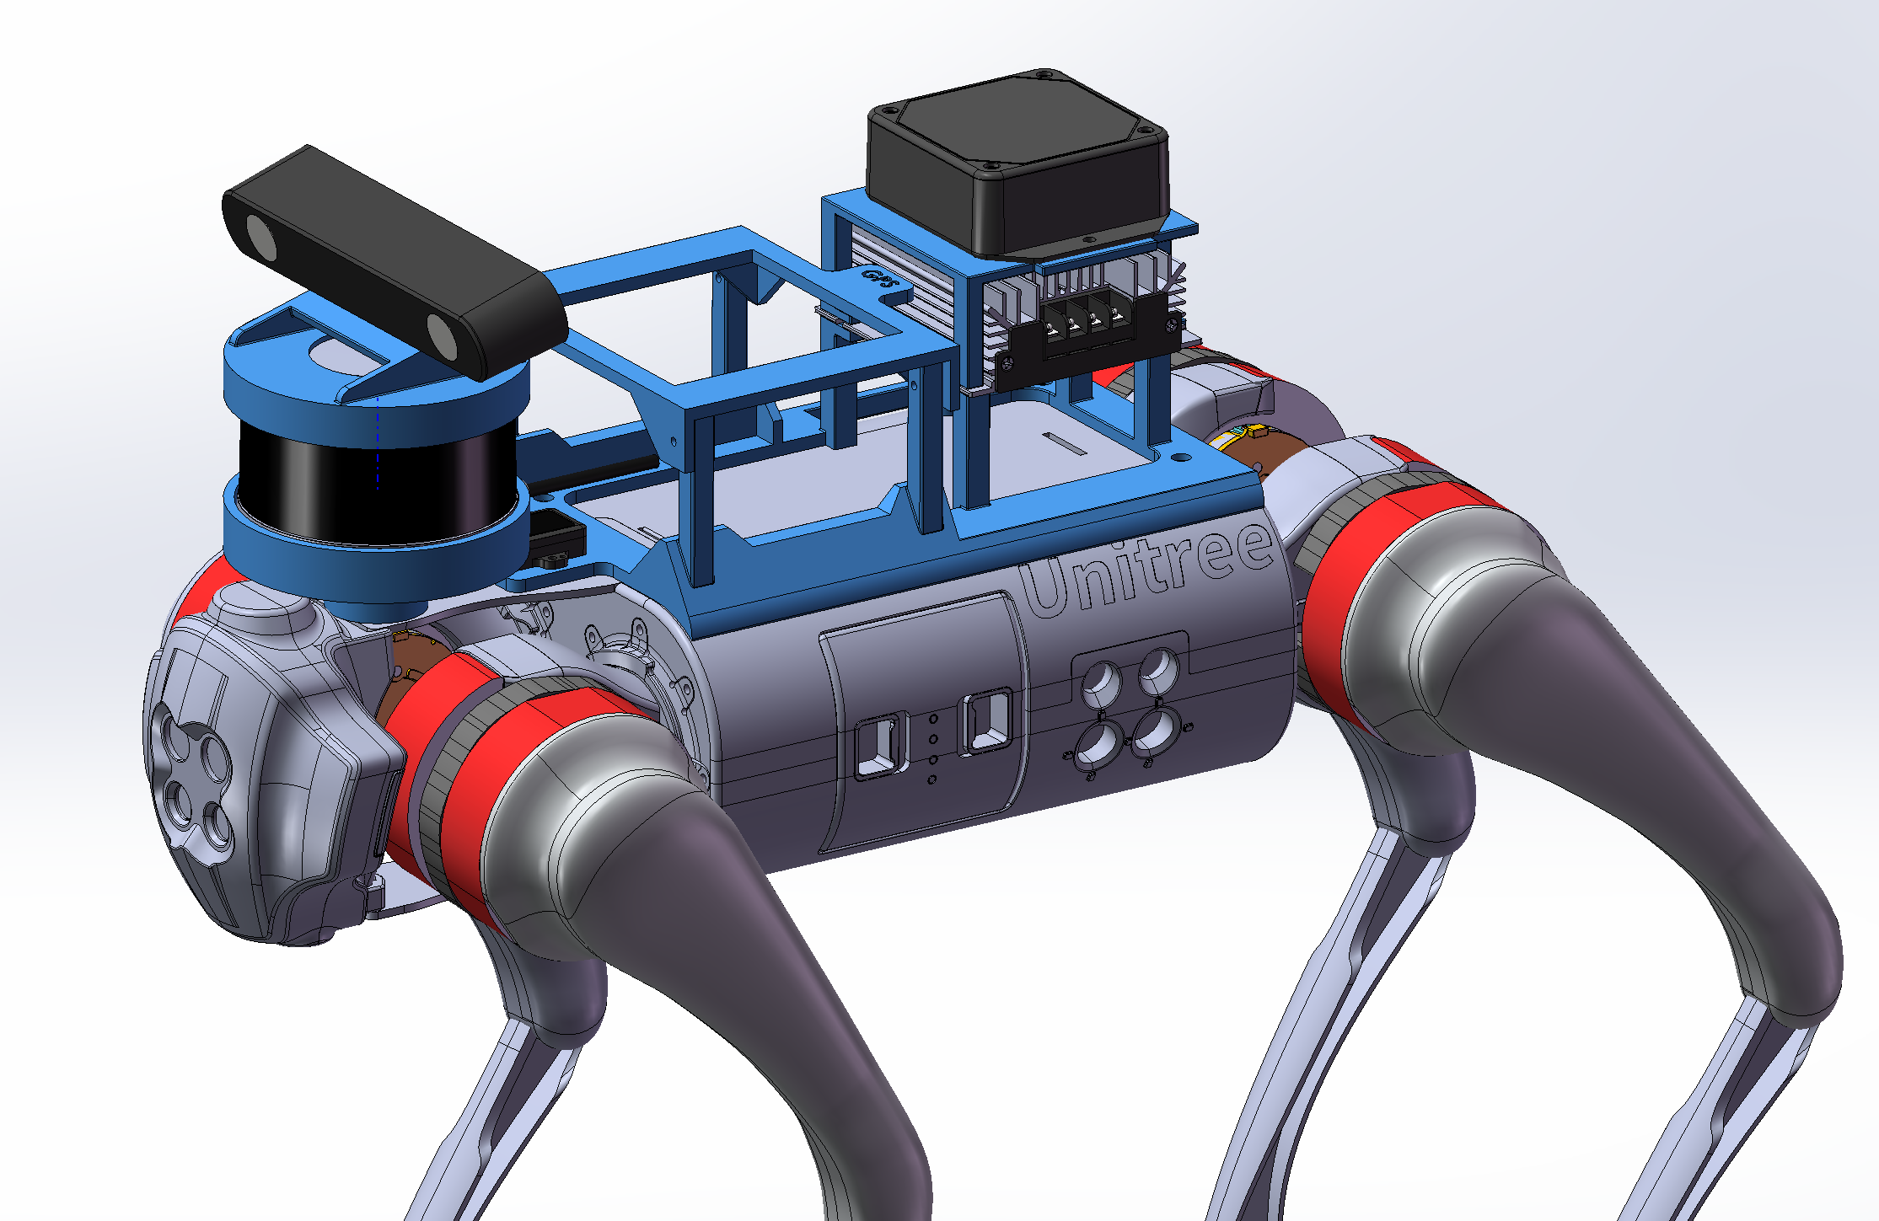
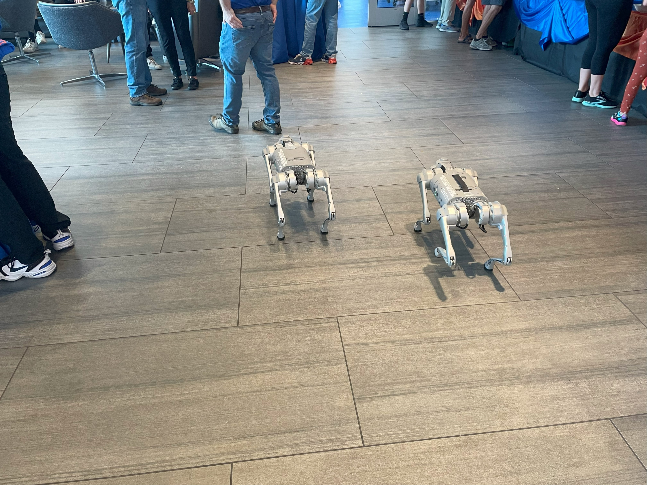
Robot Backpacks (Fall 2023 – Present)
3
Background: For a research lab, additional computers and sensors needed to be onboard quadruped robots to support experiments. A compact “backpack” to mount the components was required.
Design: The final design, highlighted in blue, combines sensor visibility requirements with port access. Space constraints meant components had to be stacked vertically to stay clear of the legs.
My design is the result of iterating over several months as additional sensors had to be added. It was very rewarding to assemble everything and watch the robot successfully complete waypoint missions with the new hardware onboard.

Slide 5
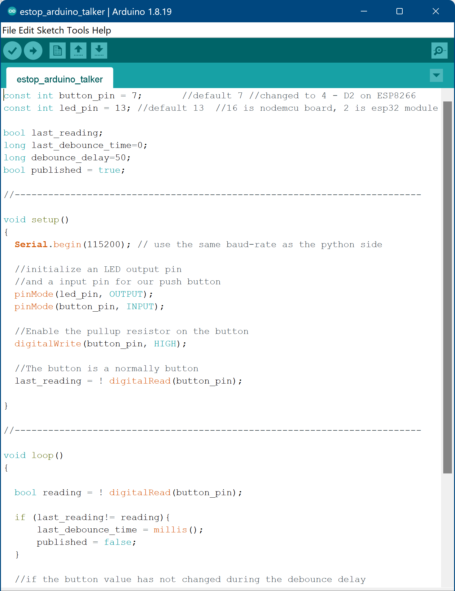
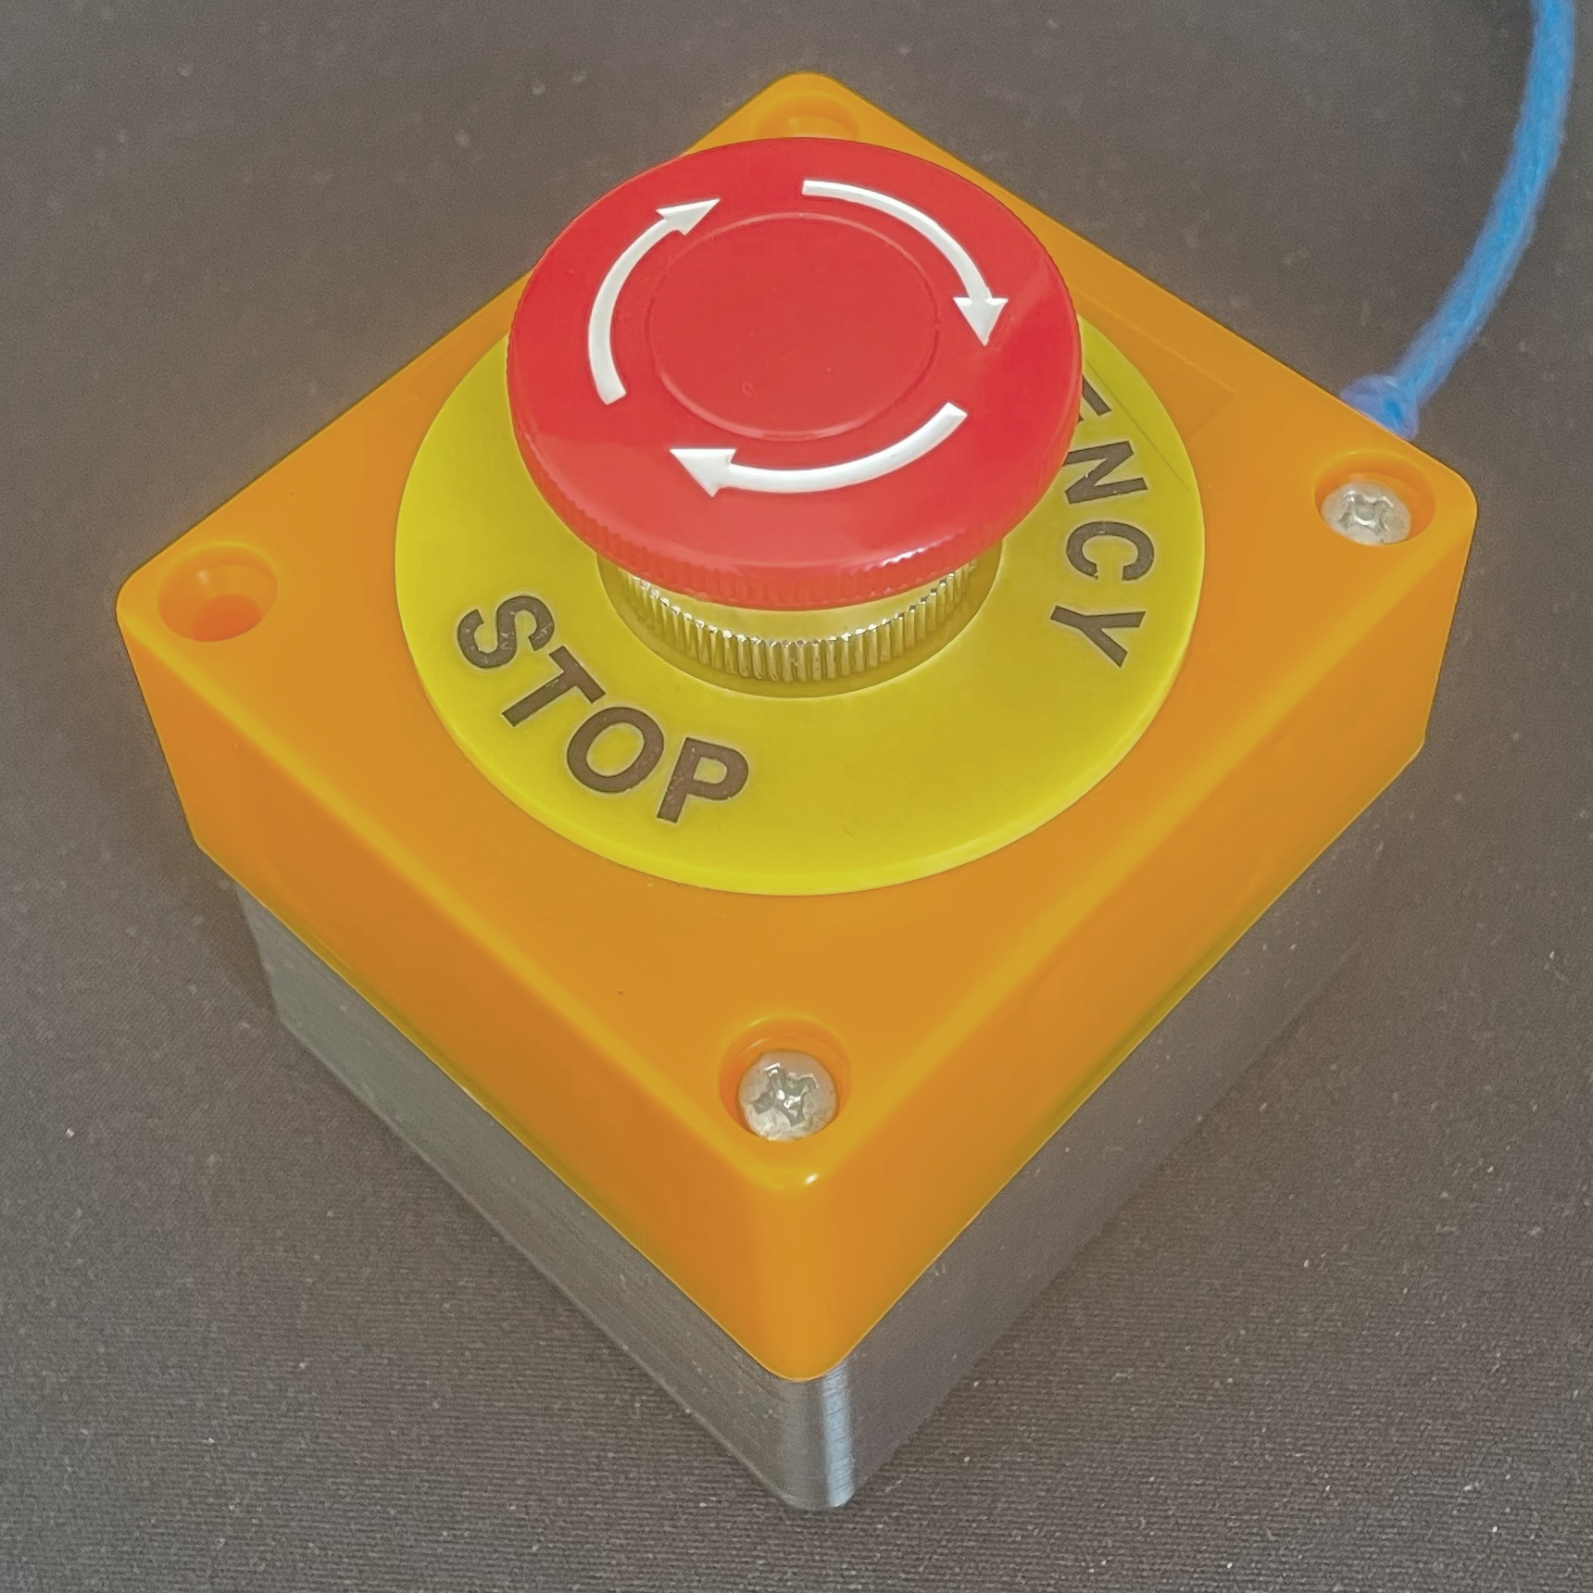
Robot Emergency Stop (Spring 2023)
4
ESTOP in NCR lab
Goal: Design a one-button system to stop many robots running different operating systems and control interfaces. It can be difficult to find the correct terminal to kill when controlling a swarm of robots.
Description: I used a microcontroller to read button status and debounce the signal when activated. A connected ROS2 node publishes on each robot’s /estop topic to stop any connected robots.
Results: This system successfully stopped robot dogs, wheeled robots, and quadcopters when tested. It is not intended to be a replacement for safety lock-out controls, but to be used to stop everything when one robot is about to crash into something.

Slide 6
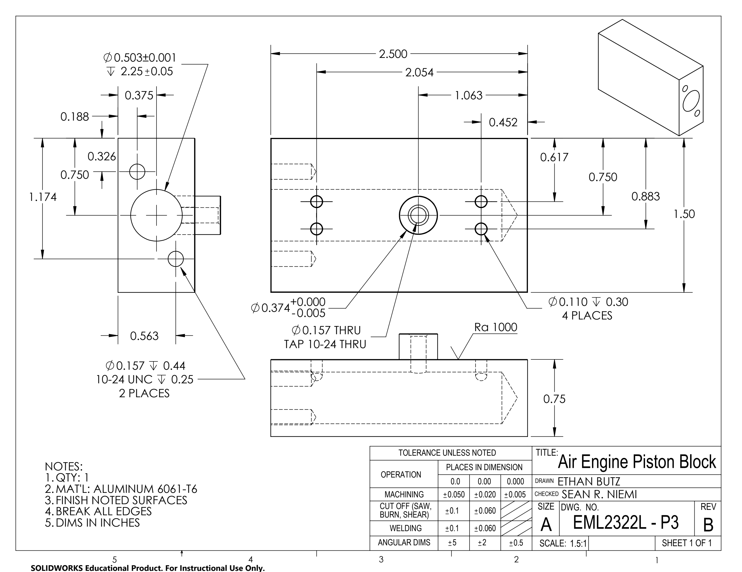

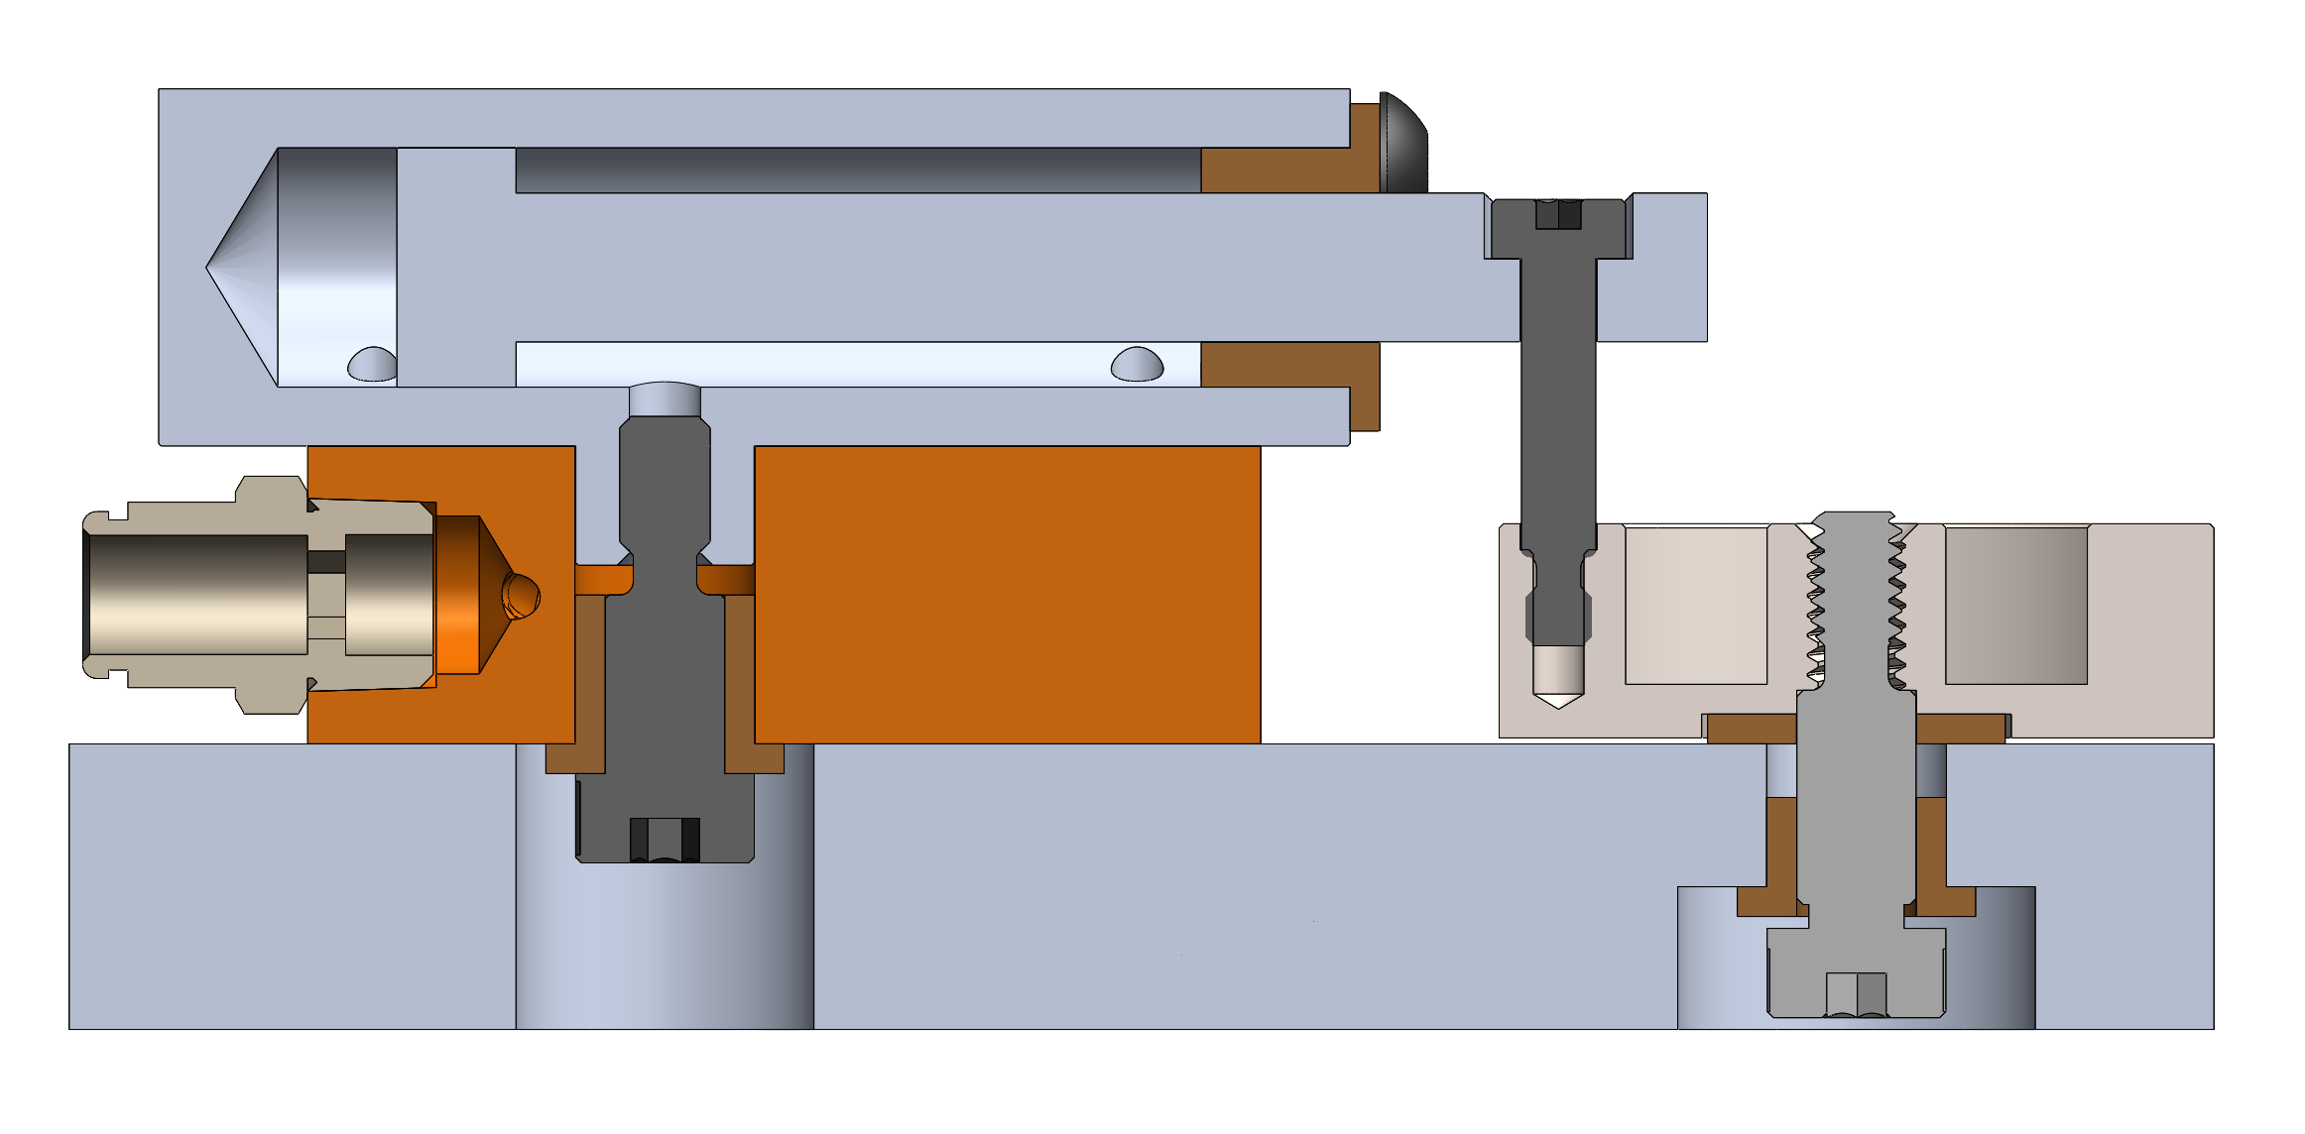
5
Design and Manufacturing Laboratory Air Engine (Fall 2023)
Objective: Manufacture 6 discrete components and assemble to create 4 functional air engines.
Process: I applied Geometric Dimensioning and Tolerancing (GD&T) knowledge to revise provided air engine drawings. Reducing noncritical tolerances allowed me to more easily achieve design requirements during manufacturing. I learned how to identify critical surfaces and got to see firsthand how high tolerances impacted manufacturing time.
I also learned how to preform manual mill and lathe work, and how to generate g-code in Autodesk Fusion for Haas VF-3 CNC mills.

Slide 7
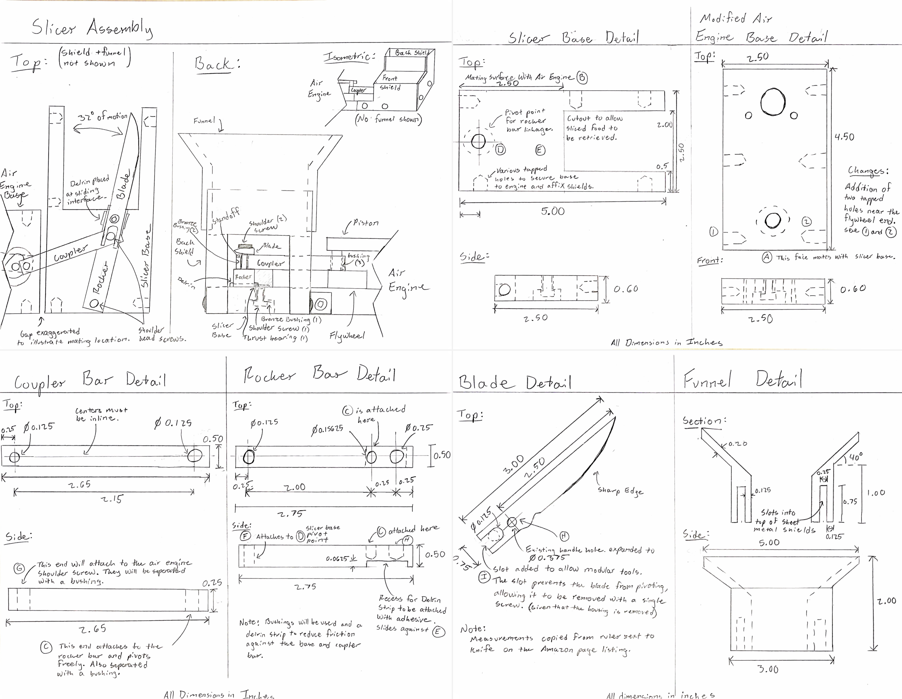
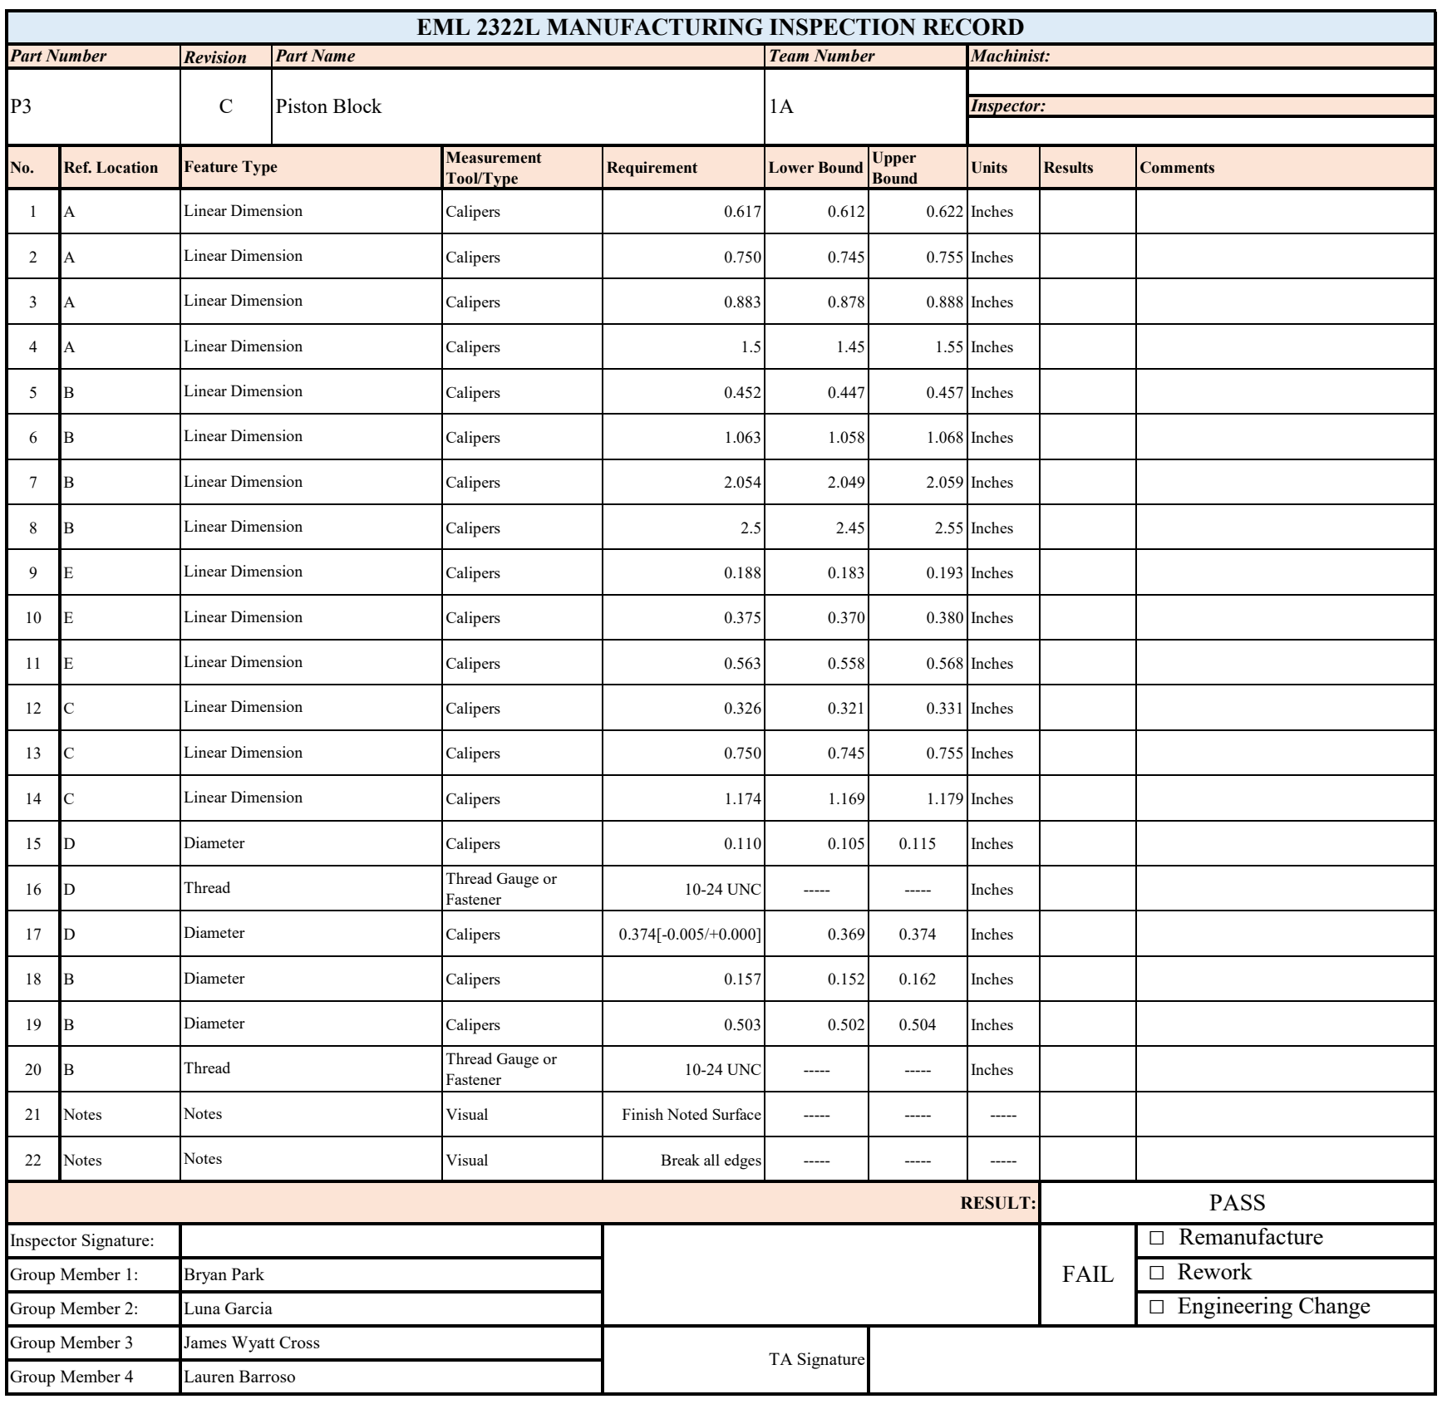
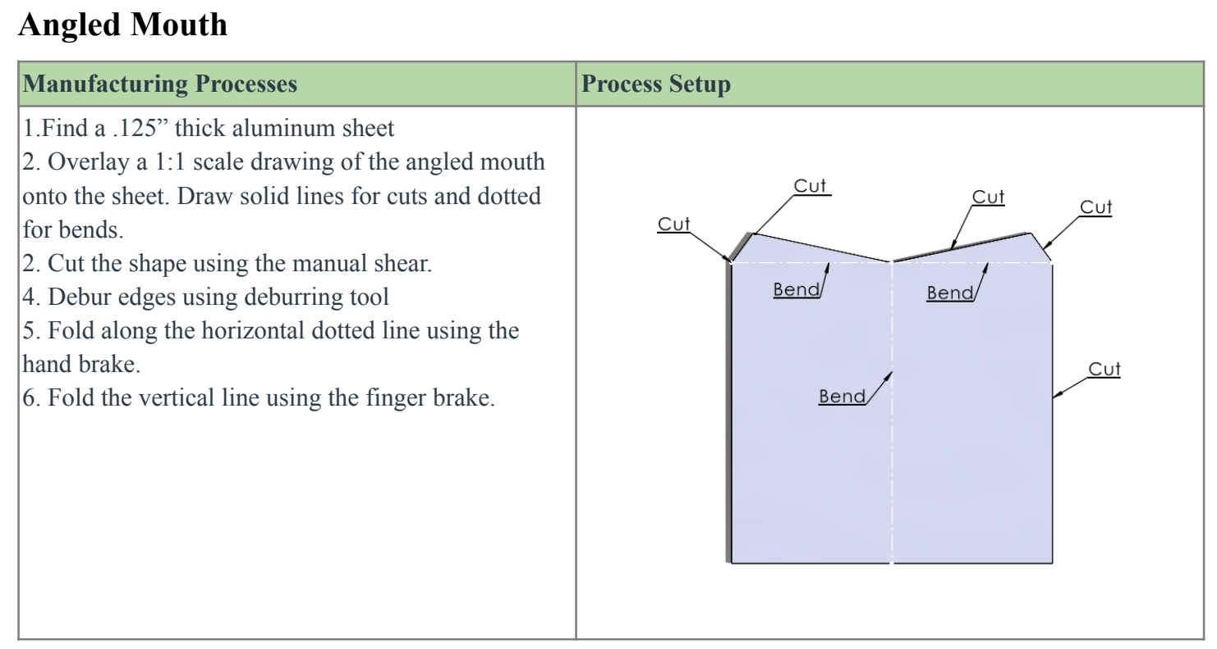
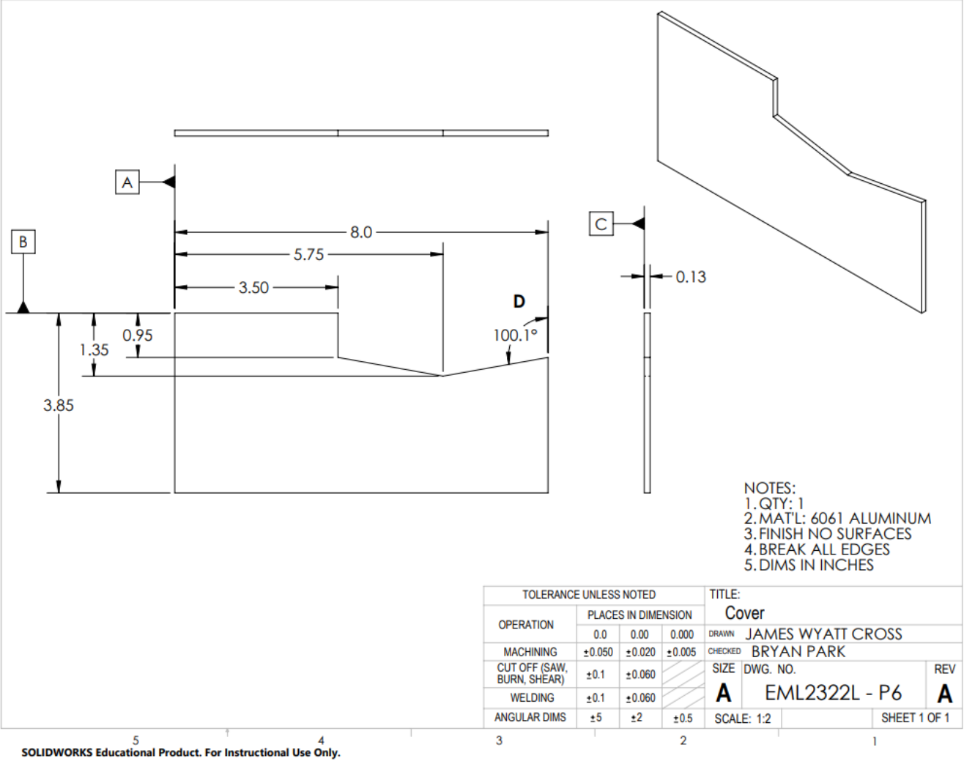
Design and Manufacturing Laboratory Technical Reports (Fall 2023)
6
Objective: Design a novel mechanism that does not use gears or belts to transfer power from the Air Engine flywheel to a cutting blade.
Process: I designed a reciprocating radial slicer that relied on a two-bar linkage and created dimensioned sketches for each functional part. Manufacturing Inspection Records and toleranced Engineering Drawings were created for each part. Finally, detailed manufacturing instructions were created for each part.
Results: I learned how engineering processes are documented and conveyed to machinists, quality control, and assembly. Cost was also a factor, and I learned to keep raw stock sizes in mind when designing.

Slide 8
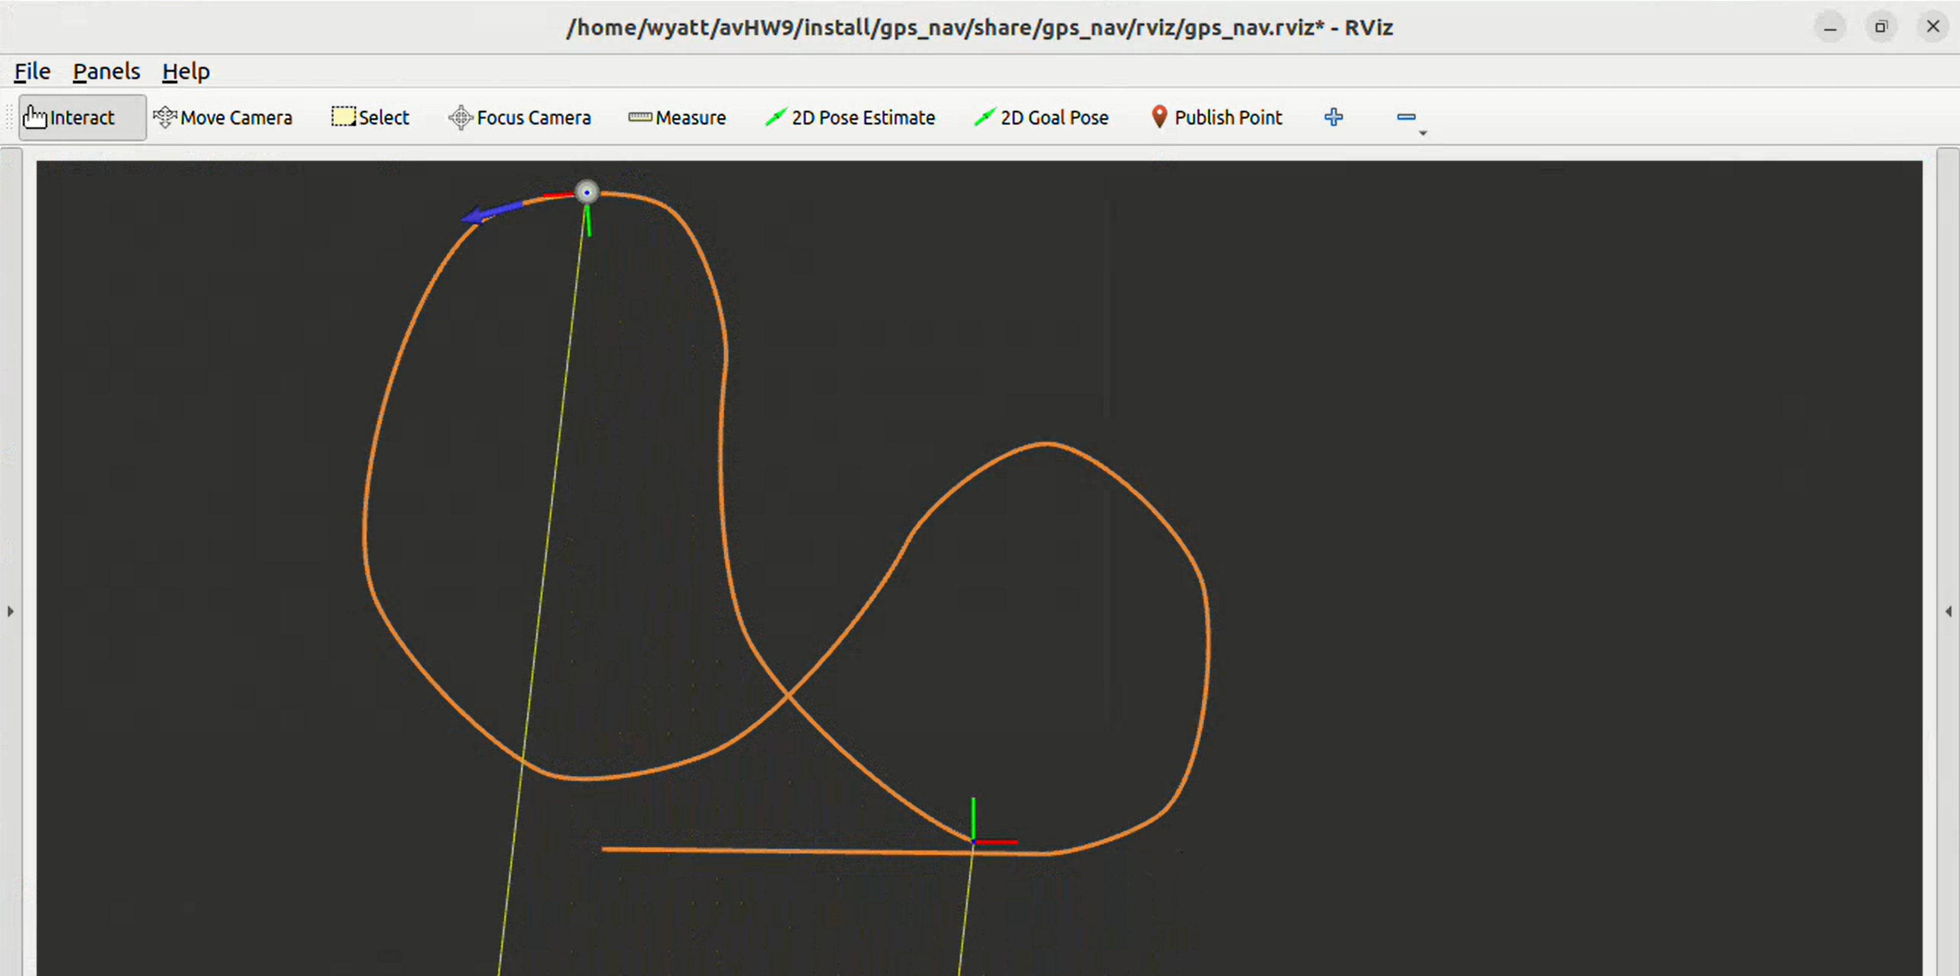
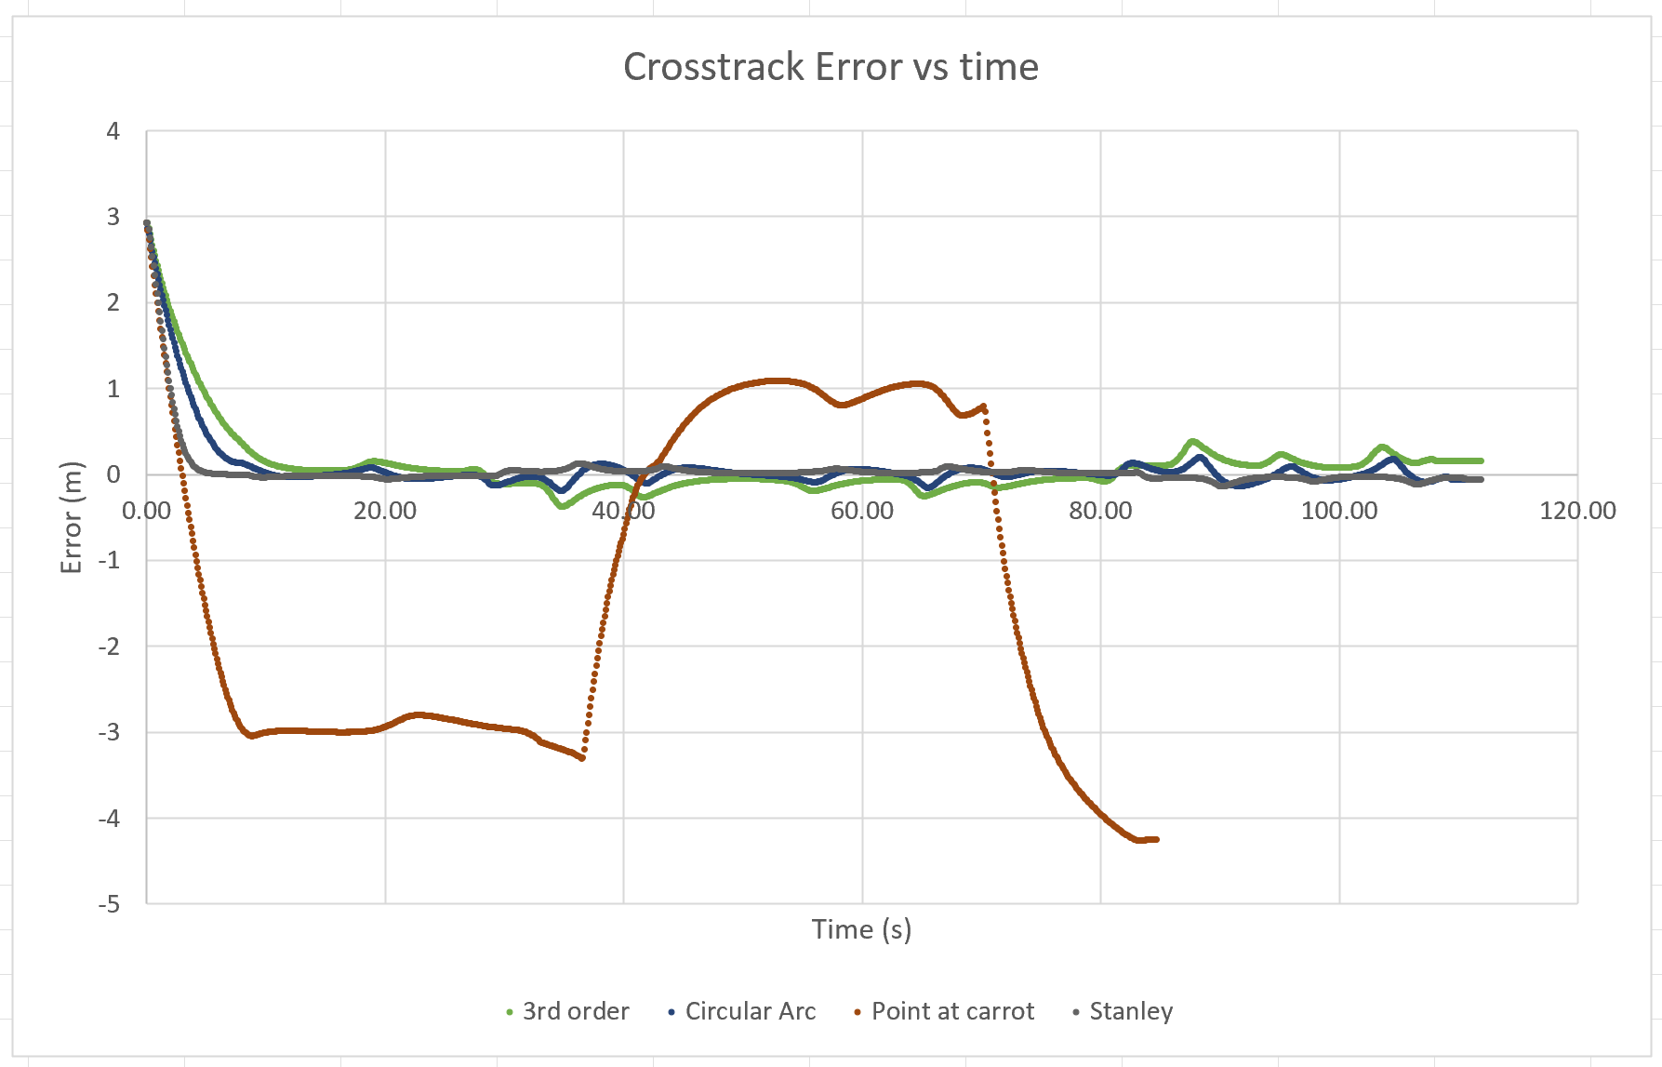
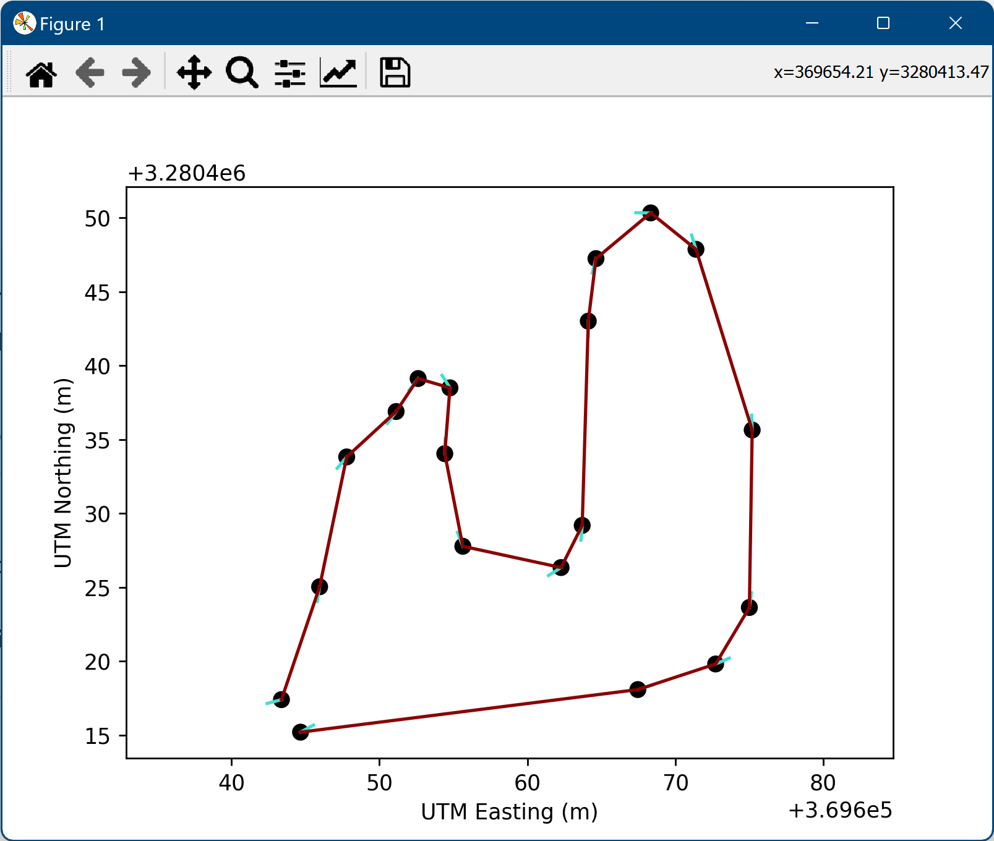
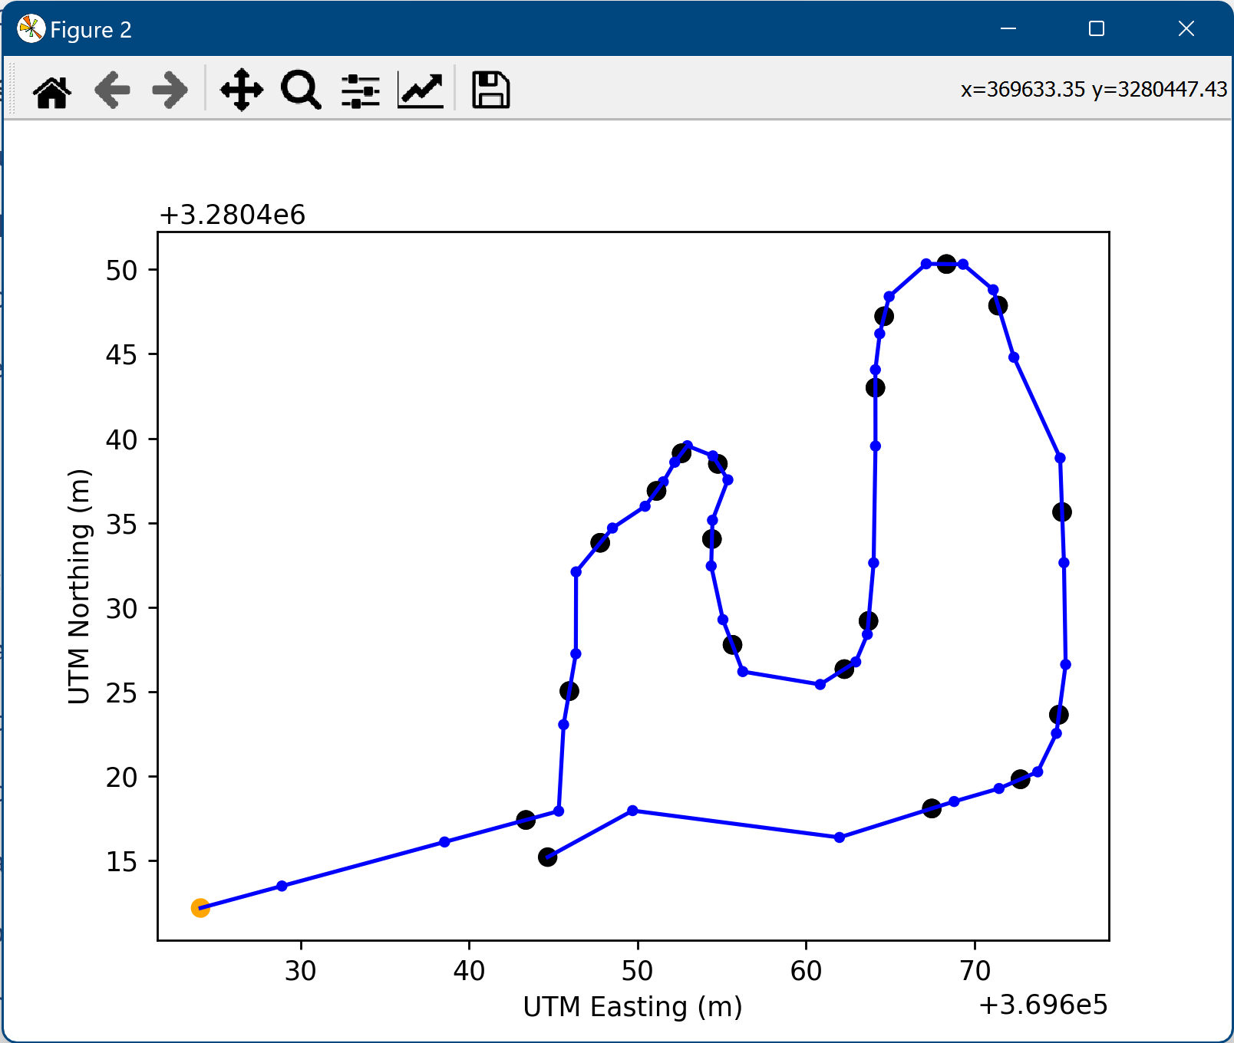
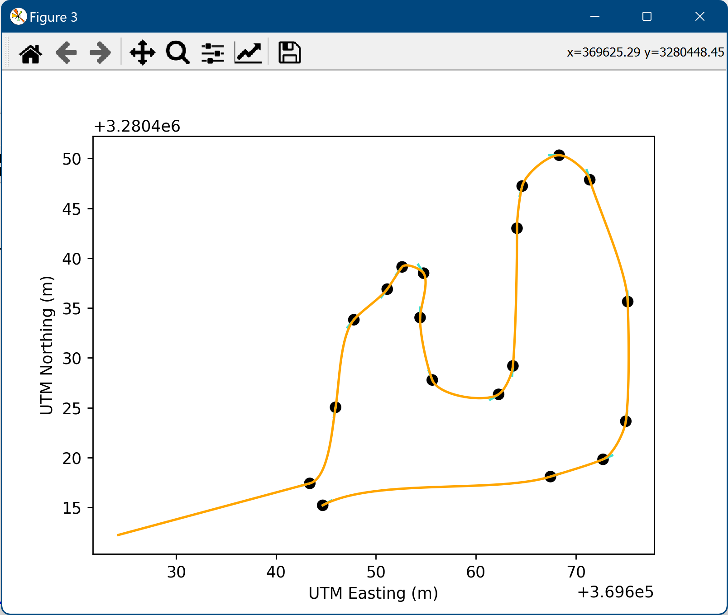
Autonomous Vehicles Class (Fall 2023)
7
Background: This was a technical elective I took that focused on learning how autonomous vehicles navigate in the real world. Shoebox-sized wheeled robots were used. They were equipped with GPS and LIDAR sensors.
One of the major assignments was getting the robot to travel along a predefined path. The top two images are results of testing my implementation of various waypoint following algorithms along a simulated path. I opted to use a Stanley controller. The lower 3 images show route planning. I selected UTM points from Google Earth and learned how to turn a list of waypoints into a smooth path for the robot to follow.

Slide 9
Title
#
Background:
Design:
Problems:
Solution:
[comments]
Or
Background/Model/Results
Goal/Description/Future Work

